Slide 1
Math Matters
Math Instruction/Learning for 21 Century Students
Suzanne K. Fox sfox@oswegoboces.org
Notes:
Introductions

Slide 2
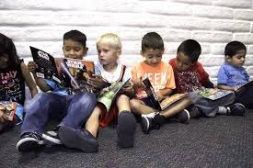
Learning Targets
I understand the three major Common Core Math Shifts and how they shape math instruction and learning
I can use the reports of the easyCBM to determine areas in need of support for my students
I can find specific material to assist in math instruction based on standards, fluencies, foundations, and vocabulary
Notes:
Learning targets are taking the place of an agenda. Rather than what I would like to accomplish with a list that I understand, learning targets keep the teaching and learning focused on the student and what we would like him/her to be able to do.
So you all will be wearing two hats today, one of student and one of teacher

Slide 3
Fractions
Notes:
Our opening exercise today will have to do with fractions……..Please take out the 4 by 6 grid from your folders. Ask participants to shade in 3/8 of the diagram any way they want.

Slide 4
Notes:
This is the way I shaded in three-eighths when I was given this task in a workshop sitting in your positions. I counted out 8 squares and shaded in 3 of them, then did the same again and then again. Yes this is nine – twenty fourths, and it is also 3 eighths. Have participants get up and do a gallery walk to see how other people shaded in their three-eighths.

Slide 5
The Shifts in Math Instruction
Working Memory
Rigor
Is this the answer to the age old phrase..” I was never good at math”?
Notes:
The activity we just did, can help to explain the shift in math instruction from traditional to common core

Slide 6
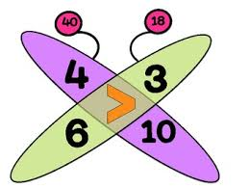
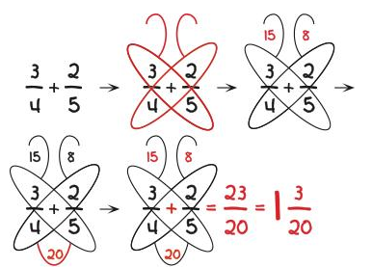
The Butterfly rule
https://www.youtube.com/watch?v=g0nuomCCu9A
Notes:
Play the video. Could you learn how to add and subtract fractions without understanding what a fraction really is?

Slide 7
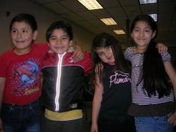
Memorizing Numbers
9 12 7 10 5 8 3
Notes:
Show the pattern - 10 seconds to memorize. No writing them down. Can they give the next number in the pattern?Revealand get people to understand random vs number sense. Random memorized or pattern – which is easier, which has the numbers making more sense? The focus of the common core in number sense…

Slide 8
Focus and Coherence with attention through the Numbers and Operations Domain
Notes:
So this is what math is all about. This is how math now builds on itself. Numbers and operations – and the number sense associated with it is a major shift in the teaching and learning of math. One of the premises is that if a student develops a strong foundation in number sense, then there will always be an avenue to engage in independent thinking rather than learned helplessness. Strategies and modeling are key.

Slide 9
http://jeffbaumes.github.io/standards/
Notes:
The coherence……ask participants to write this down as they may want to use and explore during the work time. Then go and show the site.

Slide 10
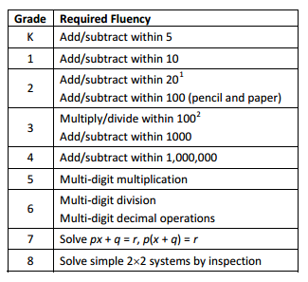
Fluency
Automaticity
Grade 2 note: By end of year, know from memory all sums of two one‐digit numbers 2
Grade 3 note: By end of year, know from memory all products of two one‐digit numbers
Notes:
Students can focus on more in depth understand with the common core and this leads to using the algorithms with a purpose. being fluent and automatic “frees up” the working memory so that students can focus on more in depth understanding be prepared for productive struggle in the rigor, the fluencies themselves build on each other for coherence,

Slide 11
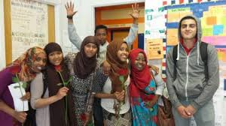
Don’t do this!
Notes:
Ask participants NOT to solve 5 x 5. How many did it anyway?

Slide 12
Rigor
One-third of the 450 students at Mason Middle School walk to school. Of the remaining students, 2/5 ride the bus and the rest are driven to school. How many students are driven to school?
https://www.engageny.org/sites/default/files/resource/attachments/how_to_implement_a_story_of_units.pdf
Notes:
Ask people to solve the problem. Then ask them to take out the tape diagram page. Model how to solve this word problem using a tape diagram. Use the chart paper. Did you need to know an algorithm or a strategy. Does this make sense to you?
Modeling allows students more entry points into an application problem than an algorithm.
What is rigor – write down on a sticky note and hide.

Slide 13
Rigor provides positive experiences, is an emotional high, and engenders a pervasive sense of accomplishment students will carry for years--and use as a template for future events.
Rigor is NOT lots of homework, projects, resources, or rules. When those four nouns are used to define rigor, the teacher is flailing, thinking quantity is quality. Rigor is not about adding a column of data or remembering the main characters in a Shakespeare play. It's seeing how knowledge connects to life, to circumstances, and to daily problems.
Notes:
Look at the two and take a minute to read to yourselves. After reading, does this alter your initial definition of rigor?

Slide 14
Simply put, adding rigor creates an environment where students are:
Expected to learn at high levels.
Supported so they can learn at high levels.
Cheered on as they demonstrate learning at high levels.

Slide 15
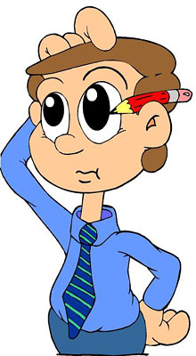
How can I add rigor to my practice?
http://www.teachhub.com/22-ways-add-rigor-your-classroom

Slide 16
Make it easy to decode words by adding an online dictionary or a backchannel that students can access with unknown words.
Build grit in students. Let them know they are capable, competent, that thinking hard does not mean they didn't understand. It means they want to understand.
Don't draw conclusions for students. Present them with evidence. See where it takes them.
Expect problem solving. Don't jump in to solve problems. Provide students with strategies they can use and let them try them.
As students participate in class conversations, expect them to use academic and domain-specific vocabulary. If they use words like “something,” “you know,” “that,” or “like,” prod them to come up with specifics. Like what? No I don't know. This immerses them in learning, discovering, and thinking critically.
Notes:
Who is picking up the pencil?

Slide 17
DOK
What DOK level is the question?
Or
What the heck is a DOK?
DOK determines the rigor of a question.
Notes:
You will need your DOK chart from the folder. Use the kaplinski dok examples to show how one problem can be elevated to the next level.
How many steps to solve? Is this independent of the vocabulary?
Now take out the grade 4 easyCBM test.
Have participants do the dok levels of grade 4 (the number of questions done depends on the time) and use highlighters for specific vocabulary that might be an issue

Slide 18
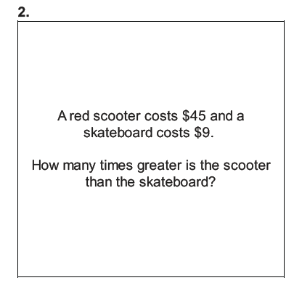
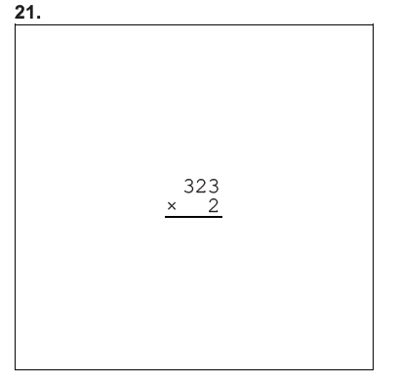
The Questions…..(about the questions)
Notes:
These are both multiplication, finding the factor and finding the product
Why not teach simple dividing as finding the factor in multiplication
Do you see the DOK and the rigor of one problem compared to the other? Which is more real life and which shows that “thing” called math

Slide 19
Educating the migrant workers’ kids
Notes:
Video on how little these kids are when they start their journey

Slide 20
Charting the Path for Your Students
Using Easy CBM to navigate your path in mathematics
Notes:
This power point will help you:
See the types of questions your students are answering in their Easy CBM benchmark assessment
Use Easy CBM reports to determine strengths and areas to focus on for your students

Slide 21
Targeting Instruction Based on Data Analysis
Standards – major, supporting, additional
Fluencies – computational, procedural
Foundational Standards
Vocabulary – application problems
Notes:
So hopefully I have been able to sway your minds to math…math in terms that the common core standards are meant for increased success, increased understanding of math and increased ability for learning more complex math that is actually relevant.
Four areas that you can target to get the most bang for your buck are above and we will target each.

Slide 22
What are the standards?
Major Emphasis/Foundational
Supporting
Additional
Notes:
To use standards, we need to understand the basics of how they are ranked. You will need the colored green/blue/yellow sheet for grade 4. You have all the grades 3-8 as you may not have a student who is grade 4 and need those additional support scaffolds.
You will also need the grade 4 easyCBM test.

Slide 23
Notes:
This is from the initial power point. This is the prep work you did for one of your students.

Slide 24
Notes:
This is the data from three students who took the grade four fall benchmark. Review the chart.

Slide 25
Standards – major, supporting, additional
Using easyCBM, the standards instructional emphasis chart, and the Common Core Learning Standards for Mathematics

Slide 26
Standards – the way to learn math for actual understanding (WOW!!)
Notes:
The standards are the key – the curriculum is the vehicle.

Slide 27
Notes:
For each of the three students, go to the task category of the most intervention needed. See colored.

Slide 28
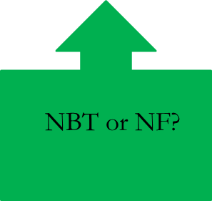
4.NBT.1, 4.NBT.2, 4.NBT.3, 4.NBT.4, 4.NBT.5,4.NBT.6,
Notes:
Look at the sheet with the green blue and yellow. I wrote the standards that most closely matched the task category. The one in bold is the one with the check on the chart. For the second I am not sure yet.

Slide 29
4.MD.1, 4.MD.2, 4.MD.3,4.MD.4
4.NF.1, 4.NF.2, 4.NF.3, 4.NF.4, 4.NF.5, 4.NF.6, 4.NF.7
4.MD.5, 4.MD.6, 4.MD.7
Notes:
Circles indicate post test standards
Bold indicate power standards

Slide 30
4.MD.1, 4.MD.2, 4.MD.3,4.MD.4
4.G.1, 4.G.2, 4.G.3
4.MD.5, 4.MD.6, 4.MD.7
Notes:
Circle indicates post test standards

Slide 31
4.NBT.1, 4.NBT.2, 4.NBT.3, 4.NBT.4, 4.NBT.5,4.NBT.6,
NBT or NF?
Notes:
Now lets examine the next step for each of our three students. Notice each of the three will have different outcomes based on the exam

Slide 32
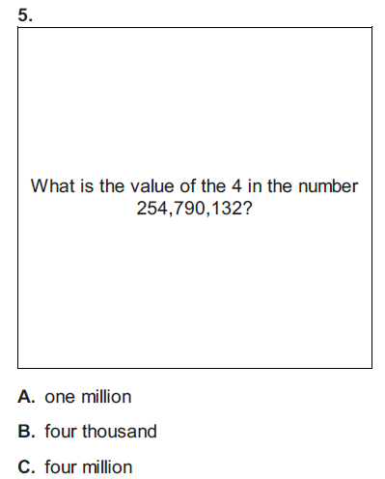
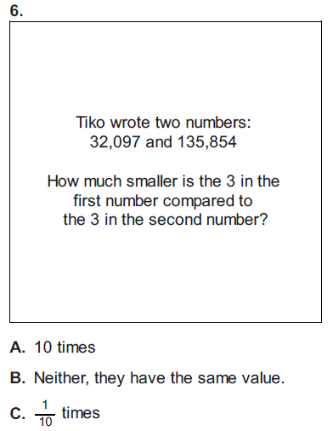
Generalize place value understanding for multi-digit whole numbers.
Recognize that in a multi-digit whole number, a digit in one place represents ten times what it represents in the place to its right. For example, recognize that 700 ÷ 70 = 10 by applying concepts of place value and division.
Read and write multi-digit whole numbers using base-ten numerals, number names, and expanded form. Compare two multi-digit numbers based on meanings of the digits in each place, using >, =, and < symbols to record the results of comparisons.
Use place value understanding to round multi-digit whole numbers to any place.
Notes:
Get out the test. Look at questions 5 and 6. they both go directly to a standard. In fact that standard is a “power standard” so it would be something you would work on wth your student.

Slide 33
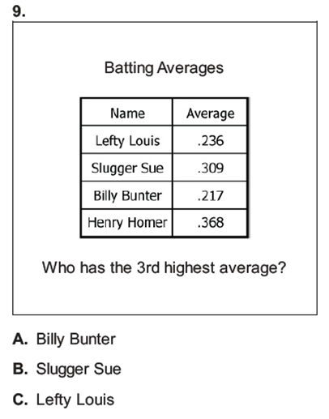
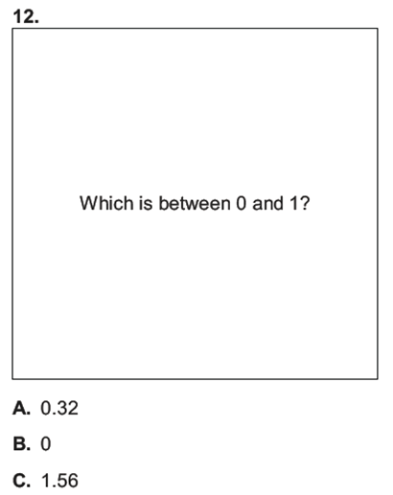
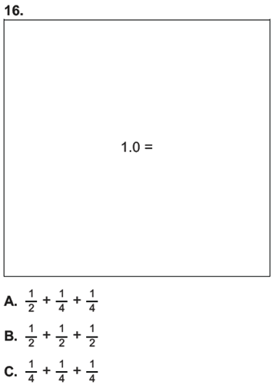
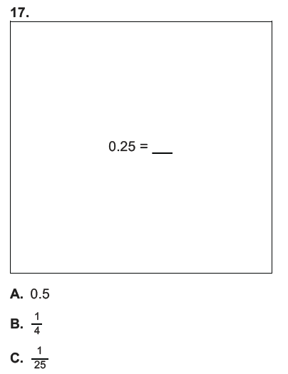
Notes:
Now we look at the other four questions. Are they fractions or base ten? They all seem to be decimal comparisons or decimals and fractions.

Slide 34
Understand decimal notation for fractions, and compare decimal fractions.
5. Express a fraction with denominator 10 as an equivalent fraction with denominator 100, and use this technique to add two fractions with respective denominators 10 and 100.2 For example, express 3/10 as 30/100, and add 3/10 +4/100 = 34/100.
6. Use decimal notation for fractions with denominators 10 or 100. For example, rewrite 0.62 as 62/100; describe a length as 0.62 meters; locate 0.62 on a number line diagram.
7. Compare two decimals to hundredths by reasoning about their size. Recognize that comparisons are valid only when the two decimals refer to the same whole. Record the results of comparisons with the symbols >, =, or <, and justify the conclusions, e.g., by using a visual model.
Notes:
So when we look at the standard that goes with this, it is post test. Should we spend time on it now?

Slide 35
4.MD.1, 4.MD.2, 4.MD.3,4.MD.4
4.NF.1, 4.NF.2, 4.NF.3, 4.NF.4, 4.NF.5, 4.NF.6, 4.NF.7
4.MD.5, 4.MD.6, 4.MD.7
Notes:
Student R has all of these which are post test (circled)

Slide 36
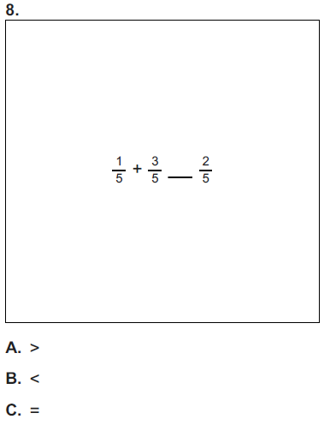
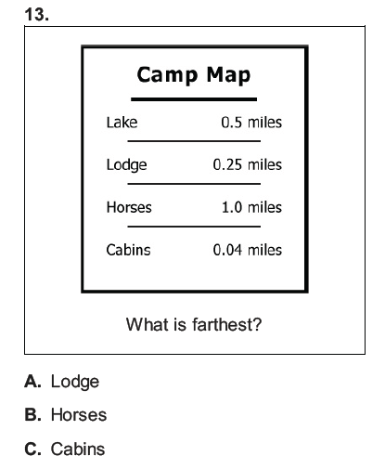
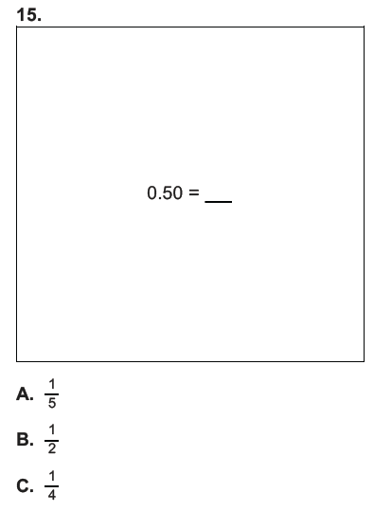
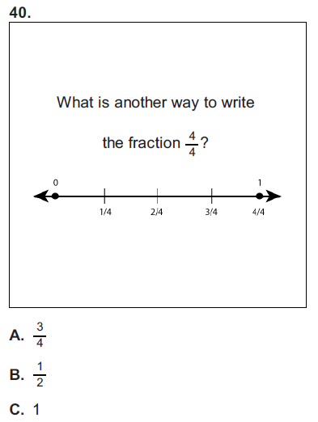
Notes:
Decimal fraction comparisons – post test

Slide 37
Build fractions from unit fractions by applying and extending previous understandings of operations on whole numbers.
3. Understand a fraction a/b with a > 1 as a sum of fractions 1/b.
a. Understand addition and subtraction of fractions as joining and separating parts referring to the same whole.
b. Decompose a fraction into a sum of fractions with the same denominator in more than one way, recording
each decomposition by an equation. Justify decompositions, e.g., by using a visual fraction model.
Examples: 3/8 = 1/8 + 1/8 + 1/8 ; 3/8 = 1/8 + 2/8 ; 2 1/8 = 1 + 1 + 1/8 = 8/8 + 8/8 + 1/8.
Notes:
So we look at the two that are straight fraction and see that this is a “power standard”. First thing to focus on in tutoring.

Slide 38
Understand decimal notation for fractions, and compare decimal fractions.
5. Express a fraction with denominator 10 as an equivalent fraction with denominator 100, and use this technique to add two fractions with respective denominators 10 and 100.2 For example, express 3/10 as 30/100, and add 3/10 +4/100 = 34/100.
6. Use decimal notation for fractions with denominators 10 or 100. For example, rewrite 0.62 as 62/100; describe a length as 0.62 meters; locate 0.62 on a number line diagram.
7. Compare two decimals to hundredths by reasoning about their size. Recognize that comparisons are valid only when the two decimals refer to the same whole. Record the results of comparisons with the symbols >, =, or <, and justify the conclusions, e.g., by using a visual model.
Notes:
The other two are as we said earlier, post test.

Slide 39
4.MD.1, 4.MD.2, 4.MD.3,4.MD.4
4.G.1, 4.G.2, 4.G.3
4.MD.5, 4.MD.6, 4.MD.7
Notes:
Student M has no green, half of supporting is post test. So lets look at the three in measurement and data

Slide 40
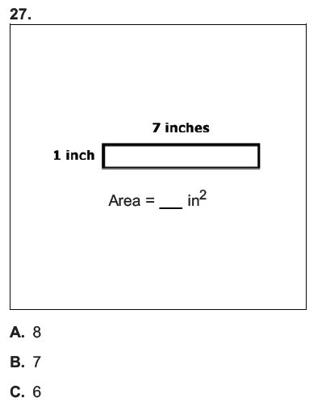
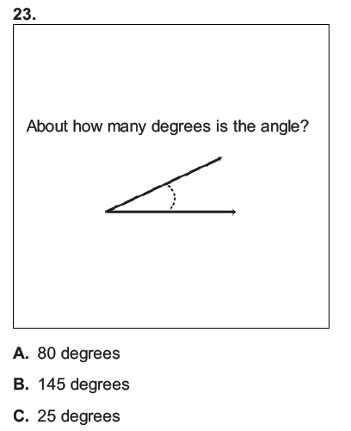
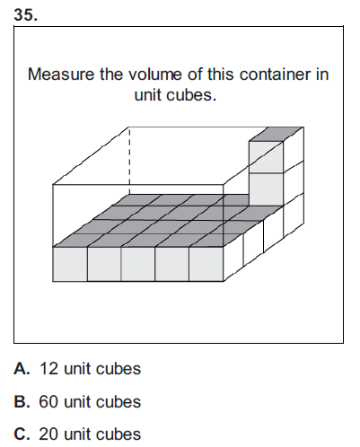

Slide 41
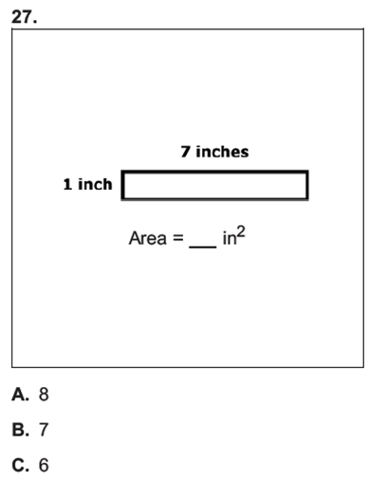
Solve problems involving measurement and conversion of measurements from a larger unit to a smaller unit.
3. Apply the area and perimeter formulas for rectangles in real world and mathematical problems. For example, find the width of a rectangular room given the area of the flooring and the length, by viewing the area formula as a multiplication equation with an unknown factor.
Notes:
Possible starting point

Slide 42
Geometric measurement: understand concepts of angle and measure angles.
5. Recognize angles as geometric shapes that are formed wherever two rays share a common endpoint, and understand concepts of angle measurement:
a. An angle is measured with reference to a circle with its center at the common endpoint of the rays, by considering the fraction of the circular arc between the points where the two rays intersect the circle. An angle that turns through 1/360 of a circle is called a “one-degree angle,” and can be used to measure angles.
b. An angle that turns through n one-degree angles is said to have an angle measure of n degrees.
6. Measure angles in whole-number degrees using a protractor. Sketch angles of specified measure.
Notes:
Angle measurements – what do you think?

Slide 43
Solve problems involving measurement and conversion of measurements from a larger unit to a smaller unit.
1. Know relative sizes of measurement units within one system of units including km, m, cm; kg, g; lb, oz.; l, ml; hr, min, sec. Within a single system of measurement, express measurements in a larger unit in terms of a smaller unit.
Post test
Notes:
Post test

Slide 44
R
Build fractions from unit fractions by applying and extending previous understandings of operations on whole numbers. 4.NF.3a, 4.NF.3b
M
Generalize place value understanding for multi-digit whole numbers. 4.NBT.1, 4.NBT.2, 4.NBT.3
V
Notes:
So we found starting points for two students and what about the third?

Slide 45
4.MD.1, 4.MD.2, 4.MD.3,4.MD.4
4.G.1, 4.G.2, 4.G.3
4.MD.5, 4.MD.6, 4.MD.7

Slide 46
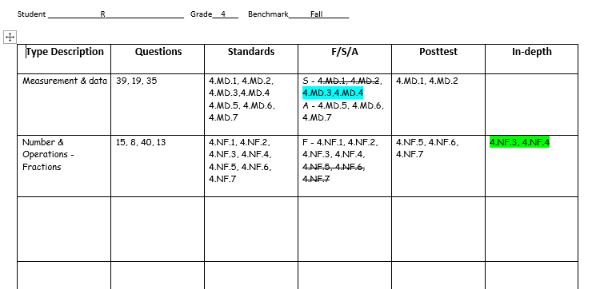

Slide 47
Targeting Instruction Based on Data Analysis
Standards – major, supporting, additional
Fluencies – computational, procedural
Foundational Standards
Vocabulary – application problems
Notes:
So we go to plan B.

Slide 48
Fluencies in grades K - 6
Notes:
Fluency and working memory computational fluency and procedural fluency

Slide 49
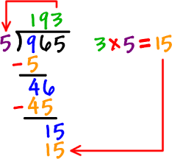
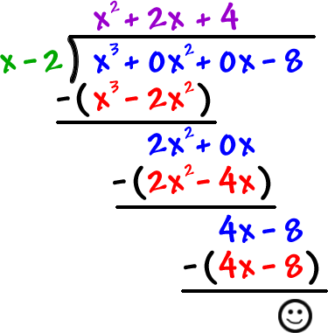
Can you believe there is a need for procedural fluency AND automaticity here?
Notes:
For grade 6 example of procedural fluency and working memory.

Slide 50
Fluency Resources
EngageNY – mathematics fluency support for grades 6-8, videos to show fluencies in grades K-5
https://www.engageny.org/resource/mathematics-fluency-support-grades-6-8
https://www.engageny.org/search-site?search=math+fluencies
Public Schools of North Carolina – Building conceptual Understanding and Fluency Through Games
https://www.chariho.k12.ri.us/sites/default/files/4thgrade_games_4.1.14.pdf

Slide 51
Targeting Instruction Based on Data Analysis
Standards – major, supporting, additional
Fluencies – computational, procedural
Foundational Standards
Vocabulary – application problems
Notes:
Sometimes students do not need reteaching, they need gaps filled in. for example if I give you directions on how to put together a bed frame and you do not know what an allen wrench is…

Slide 52
called for, essential, imperative, indispensable, mandatory, necessary, needful, obligatory, of the essence, required, requisite, vital condition, essential, imperative, must, necessity, precondition, qualification, requirement, requisite
In other words…
foundational skills make new learning “click”!
Notes:
Definitions of foundations

Slide 53
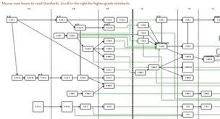
Foundational Standards/skills
Notes:
How were foundational standards mapped

Slide 54
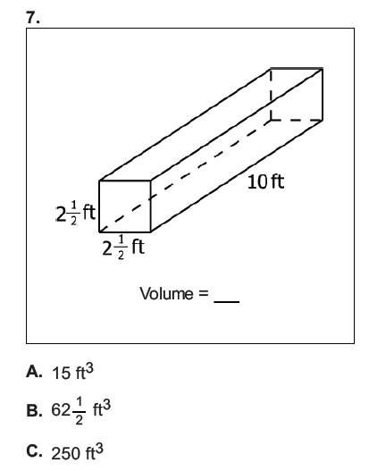
Notes:
So lets take a look at this problem…what could some foundations be missing from the student being able to completely understand what the situation is and asked to do

Slide 55
Generalize place value understanding for multi-digit whole numbers.
Recognize that in a multi-digit whole number, a digit in one place represents ten times what it represents in the place to its right. For example, recognize that 700 ÷ 70 = 10 by applying concepts of place value and division.
Read and write multi-digit whole numbers using base-ten numerals, number names, and expanded form. Compare two multi-digit numbers based on meanings of the digits in each place, using >, =, and < symbols to record the results of comparisons.
Use place value understanding to round multi-digit whole numbers to any place.
4.NBT.2
Notes:
Remember this student is to focus on place value for multidigit whole numbers? Perhaps a foundation is missing

Slide 56
http://jeffbaumes.github.io/standards/
Notes:
The coherence……ask participants to write this down as they may want to use and explore during the work time. Then go and show the site.

Slide 57
http://achievethecore.org/
Notes:
Go through basics and then to the coherence map.

Slide 58
EDpuzzle
EDpuzzle is a great tool that allows you to help students process content through video. Simply find a Youtube video on a topic of your choice; copy and paste the link into the system, and then embed questions on the video that students answer. The teacher receives responses and then knows where to plan activities to help students improve their mathematical understandings. Students can complete the video task independently or it can be done simultaneously as a whole class.
Here’s one activity you can try with EDpuzzle: Give students a link to an EDpuzzle you have created and have them complete the video activity for homework. Then, in class the next day, create several areas where students can work based on the data you have received. One area might be teacher-based direct instruction for students who are really struggling with the concept; another area might an opportunity to work collaboratively with peers on challenging problems, and a third area might require students to create problems that show depth of understanding. Want to increase the caliber a bit with this tool? You could even have students create an EDpuzzle to share with their peers. This not only ensures creativity, but also gives you a great formative assessment: the questions that students embed into the activity really help reinforce their understanding of various topics and help you, as a classroom teacher, figure out what they understand and don’t.

Slide 59
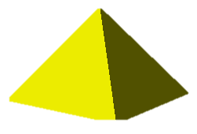

Slide 60
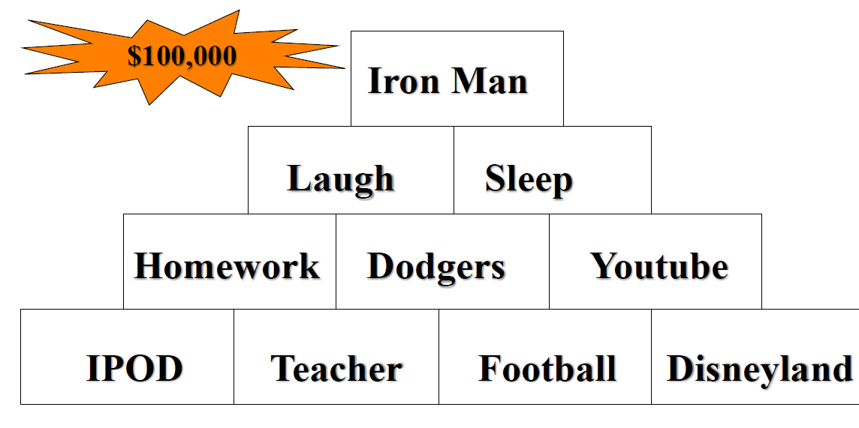
Notes:
Learning time as a student -

Slide 61
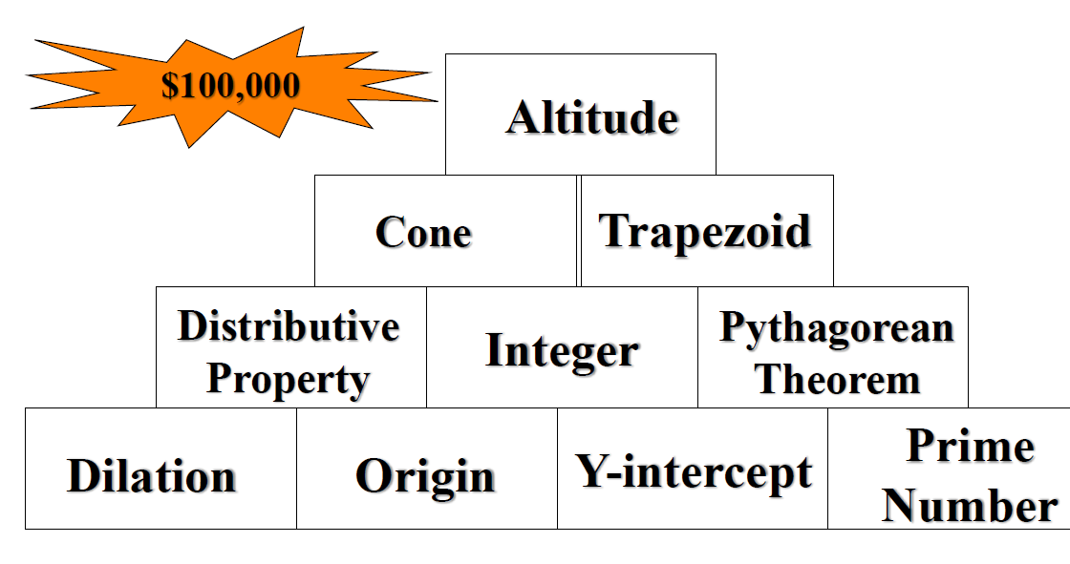

Slide 62
Targeting Instruction Based on Data Analysis
Standards – major, supporting, additional
Fluencies – computational, procedural
Foundational Standards
Vocabulary – application problems

Slide 63
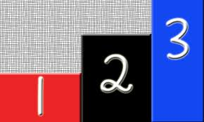
Vocabulary
Tier 1 - basic vocab
Tier 2 – academic verbs
Tier 3 - content specific
Notes:
Bring out the glossary of terms from engage ny

Slide 64
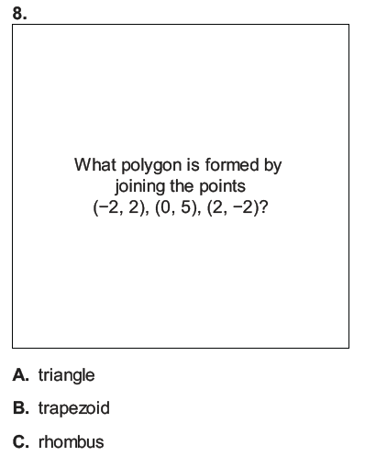
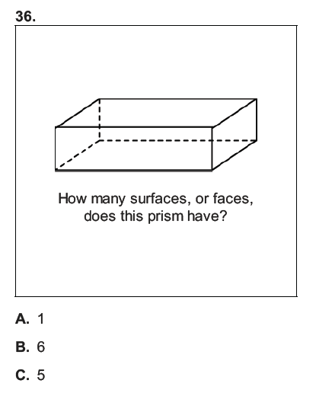
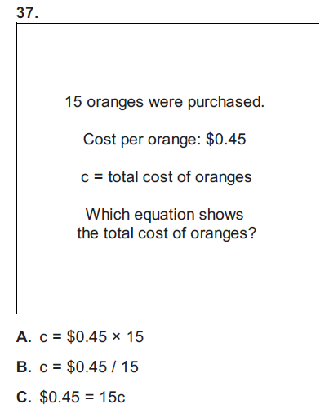

Slide 66
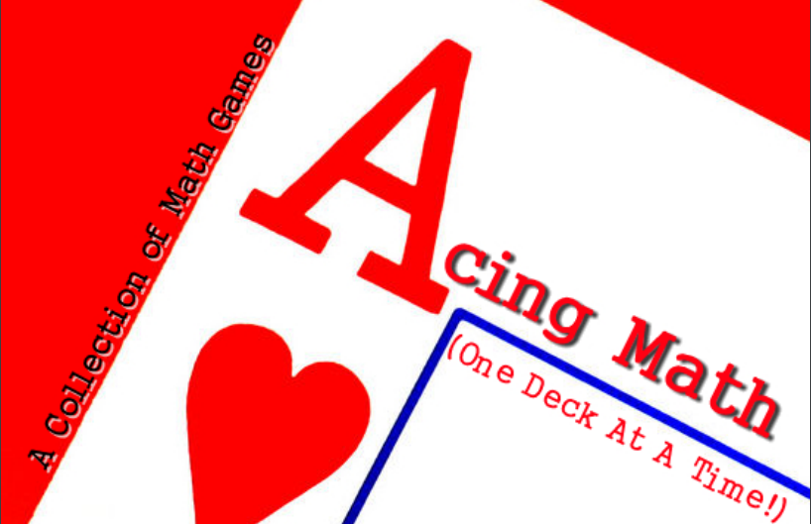
http://www.weareteachers.com/
https://learnzillion.com
http://www.esc16.net/users/0020/FACES/2013%20FACES/Handouts/Reid%20and%20Stott%20Problem%20Solving%20Math%20Card%20Games.pdf
https://www.zearn.org/
https://www.geogebra.org/materials/
http://www.commoncoresheets.com/

Slide 67
http://e2math.weebly.com/math-sprints.html
http://www.ncesd.org/Page/983
http://www.graniteschools.org/mathvocabulary/spanish-vocabulary-cards/
https://www.mathsisfun.com/definitions/
http://www.amathsdictionaryforkids.com/

Slide 68
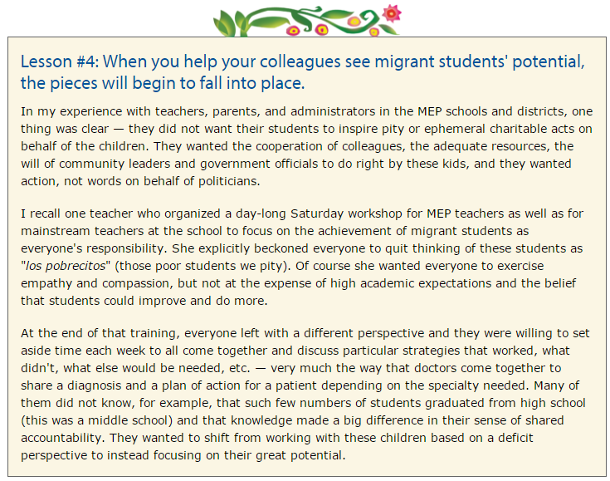
http://www.colorincolorado.org/article/migrant-students-what-we-need-know-help-them-succeed#h-strategies-for-success
Notes:
closure

Slide 69
http://achievethecore.org/aligned/?s=Focus

