Slide 1
Motivational Interviewing: Exploring Skills for Evoking Change Talk
New York State Migrant Education
2016 SDP Training – Learning Together As A State

Slide 2
Workshop Objectives
Explore the universal nature of ambivalence
Explore change talk
Explore sustain talk
Begin to develop strategies for evoking change talk and softening sustain talk

Slide 3
Ambivalence in Motivational Interviewing (MI)
Normal (a step forward from “pre contemplation”)
In teams,
What do you think ambivalence involves?
How do you think a person might feel when she/he is ambivalent?
Notes:
Simultaneous conflicting emotions
Uncomfortable
“torn between two lovers”
On the the other hand it can be a sticky place
Often remain for a long time

Slide 4
The Self-talk of Ambivalence
In teams again
What would the self-talk of ambivalence sound like?
What do you think will happen when another person tries to provide reasons etc why the other person should change?
Notes:
Pros and cons
Internally or shared with others….In MI we share with another who is compassionate, caring and deeply listening
Counterargument when you “argue” for change with the person
Talking themselves out of change

Slide 5
Change Talk
Change talk is any self-expressed language that is an argument for change
Supposing you asked for help with something…pay close attention to these responses:
“I’m sorry. I’d like to, but I’m really very busy.”
“I’ll try to get to it.”
“I might be able to do it next week.”
“I promise I’ll have it for you in the morning.”
Notes:
Continuum of commitment, it is a social signal of willingness to change. If you demand more than the person is willing to bring the sessions do not go well.

Slide 6
So…
It is helpful to not go ahead of the readiness to change that the person brings to you!

Slide 7
Preparatory Change Talk
Find a partner. Think of a behavior of yours that you would like to change but haven’t done so yet. One of your pair will be the listener (person using MI) and one will be the person thinking about change. Once you know what it is the person would like to change, seek to find out more…here are some examples:
Desire: “Why do you want to make this change?”
Ability: “What gives you confidence you can make this change?”
Reasons: “What are the reasons you want to make this change?”
Need: “Why do you need to make this
change?”
Notes:
Let’s talk about DARN None of these, alone or together, indicate that change is going to happen.

Slide 8
Mobilizing Change Talk
Preparatory change talk reflected the pro-change side of ambivalence.
Mobilizing change talk signals movement towards tipping the balance in favor of change happening
Back to your partner. Now, ask these questions:
Activation: “How willing are you to make this change?”
Taking steps: “Have you already done something towards this goal?”
Commitment: “How committed are you to
make this change?”

Slide 9
Two sides of a hill
“To say that one must, can, wants to, or has good reasons to change is not to say that one will.” Miller & Rollnick, 2013
The MI Hill
Preparatory Mobilizing
Change Change
Talk Talk
(Pre) contemplation Preparation Action

Slide 10
Let’s Practice Recognizing Change Talk!

Slide 11
A little about sustain talk…
“Sustain talk and change talk are conceptually opposite--the person’s arguments against and for change.”
Miller and Rollnick, 2013
Ambivalence contains both the arguments for change and the arguments to stay the same.

Slide 12
Something to consider…
Please remember that choices about a specific behavior may be linked to the survival responses of trauma and a person’s identity
Strategies to evoke change talk and soften sustain talk are intended to help tip the balance of ambivalence in the direction of change

Slide 13
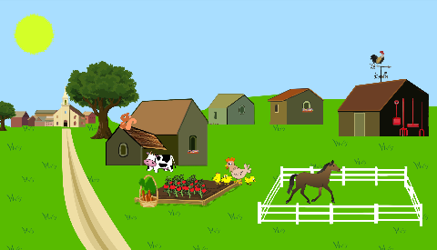
Thanks for your participation!
Cheryl Lynn Martin MA RN CASAC
Member of Motivational Interviewing Network Trainers
cmartin@ccsi.org

