Slide 1

Charting the Path for Your Students
Using Easy CBM to navigate your path in mathematics
Notes:
This power point will help you:
See the types of questions your students are answering in their Easy CBM benchmark assessment
Use Easy CBM reports to determine strengths and areas to focus on for your students

Slide 2

Knowing what you know
Good instructional practice is to always take the test prior to administering the test.
Why?
Notes:
So your students have to take a test. This test will serve as your springboard (in conjunction with speaking to the child’s teacher) to guide them in the most efficient manner in reaching targeted math goals. One of the best ways to see what your students are being asked to learn in their grade is by taking the test.
When you take the test, it serves to put you in the same mindset as your student. Taking the test allows you to see the diagrams, pictures, and the math vocabulary your students will need to know.
Also, if you see a few questions that you are unfamiliar with, that can be a good learning tool for you as well.
If you have multiple grade levels, try doing odds or evens on different tests , doing all the word problems and diagram problems. Remember that by you doing what your students are doing, puts you in the instructional mindset.

Slide 3
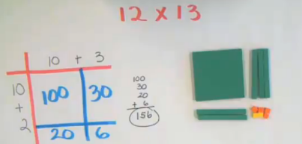

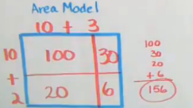

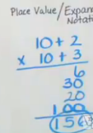

Knowing what you know
Math models
Vocabulary
Algorithms
Notes:
The math you will be tutoring will most likely have one of these three main components: modeling, vocabulary, and algorithms.
These three aspects deserve attention and will be given such during the statewide workshop.

Slide 4

Knowing what your students know
How did your student do on their baseline/fall benchmark assessment?
Notes:
The following slides will help you set up some foundational analysis in preparation for the statewide professional development workshop training.

Slide 5
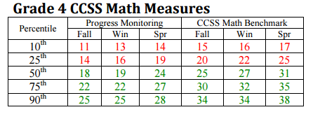
Knowing what your students know
Benchmark Raw scores to help identify student percentiles:
https://app.easycbm.com/static/files/pdfs/info/ProgMonScoreInterpretation.pdf
Notes:
If you are interested in your students’ overall performance, you can see where they fall in terms of their total score in relation to norms. These percentiles can be found through the Easy CBM website or the link here. The students’ raw scores can be compared to the scores and percentile equivalents. This can be helpful to see the overall picture of students’ math knowledge at the start of the year.

Slide 6

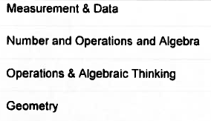

Knowing what your students know
Prioritizing categories in math for student intervention:
Notes:
In order to begin the preliminary work to determine the targeted interventions and needs of your students, the item analysis report will be used. The item analysis report will allow for prioritizing categories. The snapshot here shows all the categories on an Easy CBM 4th grade benchmark assessment. Notice that there are 7 categories for this grade and that Number and Operations has three areas of focus. Different grades may have a different break down of categories. It is important that when working with the data these areas are kept separate.

Slide 7
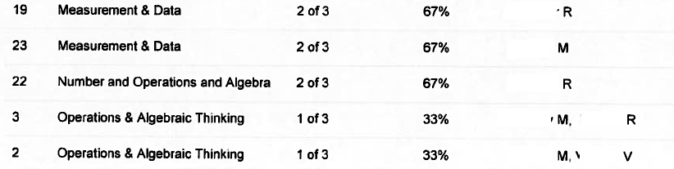
Knowing what your students know
Prioritizing categories in math for student intervention:
Notes:
This is a snapshot of the actual item analysis for the Easy CBM grade 4 benchmark assessment. Names were hidden for confidentiality. Notice that “M” has two areas in need, “R” has three areas in need, and “V” has one. (Remember that the actual item analysis consists of 40 questions.) “M” missed two questions from a single focus area. This would rank the area of Operations & Algebraic Thinking as a priority.

Slide 8
Knowing what your students know
Prioritizing categories in math for student intervention:
Determine the categories from the benchmark assessment.
Determine how many/and which questions each student missed from each of the categories.
Prioritize the categories for each student. The top two would be areas that need most improvement and become the focus for your work during the school year.
Notes:
So in order to find the top three focus areas for each of your students the following steps are used:

Slide 9
Knowing what your students know
Prioritizing categories in math for student intervention:
The seven categories from the assessment
questions the student missed
Notes:
This would be an example of a prioritized student need based on the item analysis report. This was done in Excel. It can easily be done with paper and pencil.

Slide 10
Knowing what your students know
Prioritizing categories in math for student intervention:
Notes:
Each of the three students has two areas in need of focus. An important aspect of this analysis is the ability to individualize student instruction and assistance that may not be available in the traditional school setting.
Having this preliminary data completed prior to the statewide meeting will allow tutors and teams to dig into the actual problems on the assessment as well as find the needed prescriptions for student instruction and increased understanding.

