Slide 1
Foundational Reading Skills
Kathleen Lord
SUNY – New Paltz
lordk@newpaltz.edu

Slide 2
Objectives
Review terminology (3 sections)
  Phonological Awareness
  The Alphabet, Sight Words, and Phonics
  Fluency
Understand common challenges
Learn two diagnostic assessments
Practice instructional strategies
Review activities for home practice

Slide 3
Questions and Resources
After each segment, we will pause for questions/comments
I will be available after the session for specific questions
Resources and this PowerPoint will be posted (TBD)

Slide 4
Skilled Reading
Word Recognition (foundational reading skills)
  Phonological awareness
  Decoding/Encoding
  Sight Word/High Frequency Words
  Fluency
Language comprehension
  Background knowledge
  Vocabulary
  Genre
  Structure
  Strategic reading

Slide 5
Purpose of Curriculum Based Measurements
Identifies and monitors students who might be at-risk
Quick and easy one-minute assessments
  Early reading skills
  Word recognition
  Fluency

Slide 6
Phoneme Segmentation Measure

Slide 7
Curriculum Based Measurements Assess:
Phonological Skills
  Phoneme Segmentation
Alphabetic Principle/Phonics
  Letter Names
  Letter Sounds
  Word Reading
Fluency
  Passage Reading

Slide 8
Impact of Early Reading Skills on Comprehension
Comprehension is the goal – what gets in the way?
Profile 1: Word reading skills not at grade level
Profile 2: Word reading skills strong, but fluency not at grade level

Slide 9
Phonemic Awareness: Segmentation
(Grades K and 1)
What is it?
  Ability to hear and separate individual sounds in spoken words
Why is it important?
  Spelling (and reading)

Slide 10
WHY? Phonological Awareness
Sounds not letters!
Helps students understand how spoken language is represented in print
  Children must hear the sounds … Supports spelling
  Individual sounds (phonemes) are then attached to letters…Supports reading words
Differences between phonemes may be very subtle
Phonemes can get “stuck” together (e.g. blends)
Add letters to instruction as soon as possible

Slide 11
DATA to Inform Instruction
Phoneme Segmentation
  Student cannot separate spoken words into individual phonemes
    dr…um
    tr…ain
Letter Sounds
  Student does not know the letter sound that corresponds with the letter name
    Vowel sounds
Diagnostic Assessments
  Spelling

Slide 12
Spelling Inventories
Primary Spelling Inventory and Scoring

Slide 13
Why Spelling?
Spelling is not practiced
Student must assign a letter to each sound she/he hears
Look at the spelling sample and the scoring template
We will score this together
Two inventories will be available

Slide 14
Spelling Sample Error Patterns: Grade 2
Spelling word
Student’s spelling
Pet
Gum
Sed
Gem
Fit
Chid
Coch
Pat
Gom
Sled
Dream
Fright
Tries
Coach

Slide 15
Common Challenges
Consonant blends
  Jrem; jem; gem (dream)
Short vowels
  fn (for FAN)
  pd (for PET)
Voicing confusion between similar sounds
  b/p; g/c; d/t

Slide 16
Instruction

Slide 17
Elkonin Boxes: (Sound Boxes)
How to use Elkonin Boxes
Pronounce a target word slowly, stretching it out by sound.
Ask the child to repeat the word.
Draw "boxes" or squares on a piece of paper, chalkboard, or dry erase board with one box for each syllable or phoneme.
Have the child count the number of phonemes in the word, not necessarily the number of letters. For example, wish has three phonemes and will use three boxes. /w/, /i/, /sh/
Direct the child to slide one colored circle, unifix cube, or corresponding letter in each cell of the Elkonin box drawing as he/she repeats the word.
The example (next slide) shows an Elkonin Box for the word "sheep," which consists of three phonemes (sounds): /sh/ /ee/ /p/

Slide 18
Four Centers
Groups of 5 per center
3 minutes per center
Rotate clockwise

Slide 19
CENTERS
Center 1: Elkonin Boxes (Blends for students in grade 1 and above)
DATA: PERFECT for students who did not segment
  Pictures or spoken words: tr, dr, cr, bl,…st, …nt,
Center 2: Initial Sounds (distinguish between d/t)
DATA: Supports students to hear the first sound in spoken words
  Pictures (PA 027 and pictures from PA 028) – part 3
Center 3: Final Sounds or Count Phonemes (2 players)
DATA: Supports students to hear the last sound in spoken words
  PA 029 Go Fish – Part 3: Final sound (pictures) OR Counting phonemes
Center 4: Vowels (hearing the differences)
  Short vowels (p050) part 5

Slide 20
Home Practice Activities
Beginning sound
Rhyming
Home Practice: Any activity that you have practiced together

Slide 21
???Questions about Phonemes???
Which activity will you try?

Slide 22
Letter Names, Sounds, and Word Reading Measures

Slide 23
Curriculum-Based Measurements Assess:
Phonological Skills
  Phoneme Segmentation
Alphabetic Principle/Phonics
  Letter Names
  Letter Sounds
  Word Reading
Fluency
  Passage Reading

Slide 24
Impact of Early Reading Skills on Comprehension
Comprehension is the goal – what gets in the way?
Profile 1: Word reading skills not at grade level
Profile 2: Word reading skills strong, but fluency not at grade level

Slide 25
Letter Names and Letter Sounds
(Grades K and 1)
What is it?
  Ability to name letters
  Ability to provide letter sounds
Why is it important?
  Spelling and reading

Slide 26
DATA to Inform Instruction
Letter Names
  Student does not know the letter names - upper and lower case
Letter Sounds
  Student does not know the letter sound that corresponds with the letter name

Slide 27
Instruction:
LETTER Names and LETTER Sounds

Slide 28
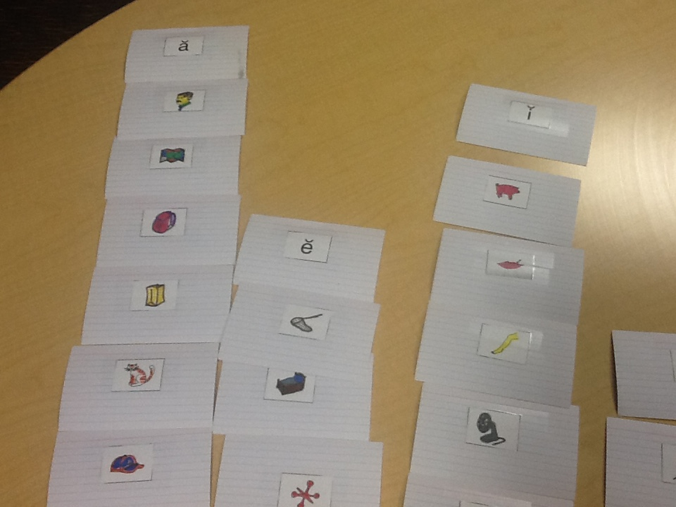
Letter Sounds

Slide 29
CENTERS: ADD LETTERS
Center 1: Elkonin Boxes
  Letter tiles
Center 4: Vowels (hearing the differences)
  Letter tiles

Slide 30
Home Practice
Letter matching – upper and lower case
http://www.readingrockets.org/strategies/alphabet_matching

Slide 31
Word Reading

Slide 32
Word Reading Fluency
(Grades K - 3)
What is it?
  Ability to read words accurately
  Ability to read words automatically
Why is it important?
  Support reading fluency and comprehension

Slide 33
What do you do when a child cannot read the words?
Diagnostic Assessments to Inform Instruction

Slide 34
Decoding and Spelling
Quick Phonics Screener
Spelling Inventory

Slide 35
What phonics features are being assessed?
Task 7 spoil join joy royal
Task 7 foam roast flea creak

Slide 39
Word Recognition Skills:
Instructional Sequence
Phonics skills – following the Common Core State Standards
Determine skills according to grade
  Kindergarten: Letters, letter sounds, high-frequency words at grade level
  Grade 1: Short vowel words, consonant blends, consonant digraphs, silent-e words
  Grade 2: Vowel teams and diphthongs, r-controlled vowels, multisyllabic words
  Grade 3 and beyond: Prefixes/suffixes; syllable patterns

Slide 40
Word Reading
Instruction

Slide 41
Language Experience Approach (LEA)
Student Dictates a Story
Teacher Scribes the Story
Teacher Reads the Story Aloud
Student Rereads for Practice
Story becomes an Anchor for Word Work
Continue to Build the Story and Add Sentences

Slide 42
LEA video
https://www.youtube.com/watch?v=Xa4--M9F7Kg
Try one as a group:
  Select one person as the teacher
  Start a story about something you all have in common
  The teacher scribes the story as everyone contributes
  Write at least 6 sentences

Slide 43
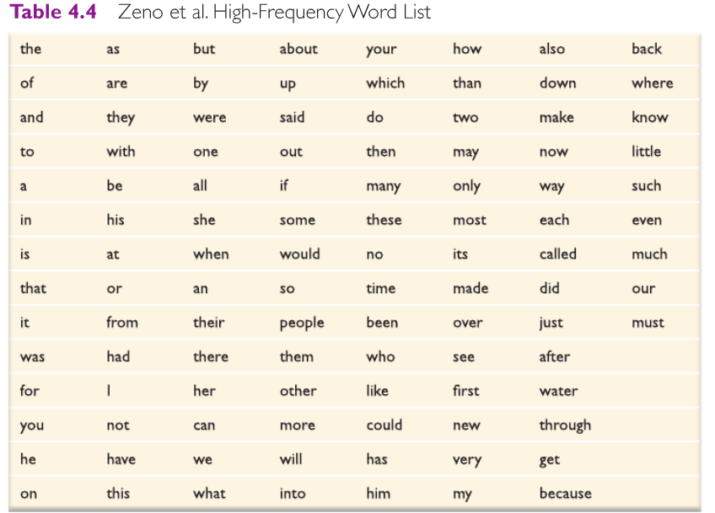
Words Found in Approximately
50% of Text

Slide 44
LEA and Word Work
Parentheses around all words with 2 syllables (read and record in notebook)
Underline words with short vowels (read and record in notebook)
Circle words with consonant blends
Bracket High-Frequency words (see Zeno list):
  AND
  THE
  Other high-frequency words

Slide 45
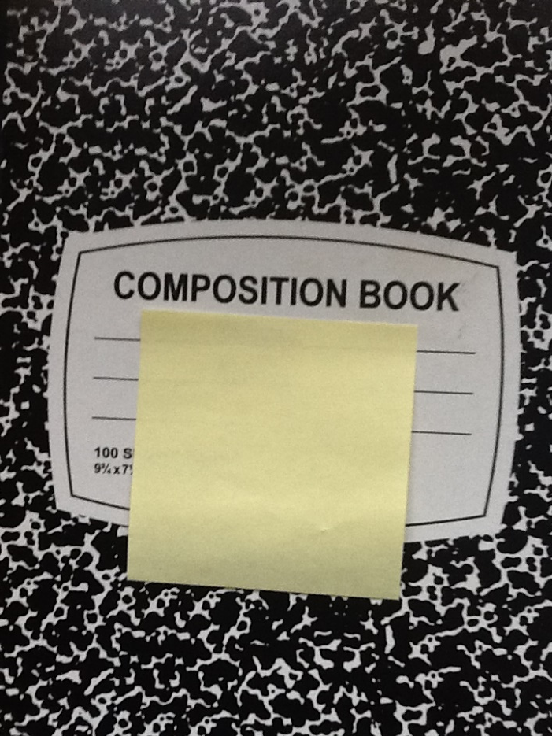
Word Study Notebook

Slide 46
Word Study Notebooks
Start Columns for word patterns
2nd grader:
  Short Vowels
  Blends
  Digraphs
Short a | Short e | Short i | Short o | Short u
Cat | Let | Lit
Map | Men | Tip

Slide 47
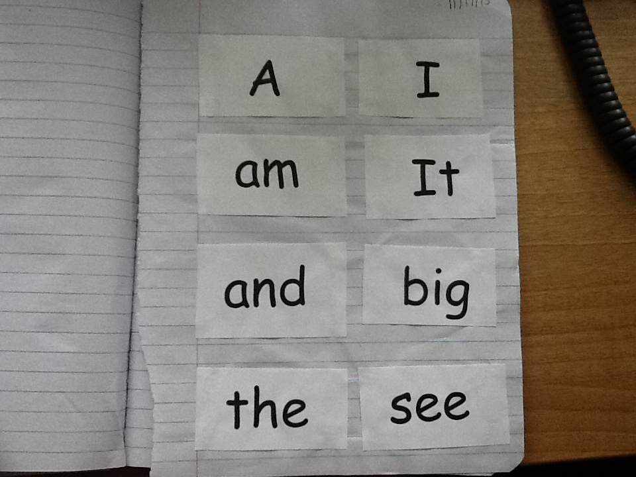
Instruction: High-Frequency Words

Slide 48
High-Frequency Words
Create Word Rings: 10 words on a ring or in envelope
    3 new words
    4 words still learning
    3 known words
  Read it, spell it, say it
  Write a sentence using the word
  Include words in a Word Study Notebook
Word Search
  A-Z readers

Slide 49
Using A-Z Readers for Word Work
Word Search based on Patterns
Organizing the Information in Word Study Notebooks
Grade 2 student
  What phonics skills does she need to work on?
Grade 7 student
  What phonics skills does she need to work on?

Slide 50
Home Practice – High Frequency Words
Word Rings or Envelopes
Word Search
Continue to add to notebook
Practice words in word study notebook

Slide 51
Advanced Phonics Instruction:
Multi-syllables
Students in grades 2 and above require instruction in words with more than one syllable:
2 effective approaches
  Syllable awareness and syllable types
  Morphemes (meaningful word parts)
    “Photo” means LIGHT
    “Therm” means HEAT
    “Inter” means BETWEEN
      INTERNATIONAL – Between countries

Slide 52
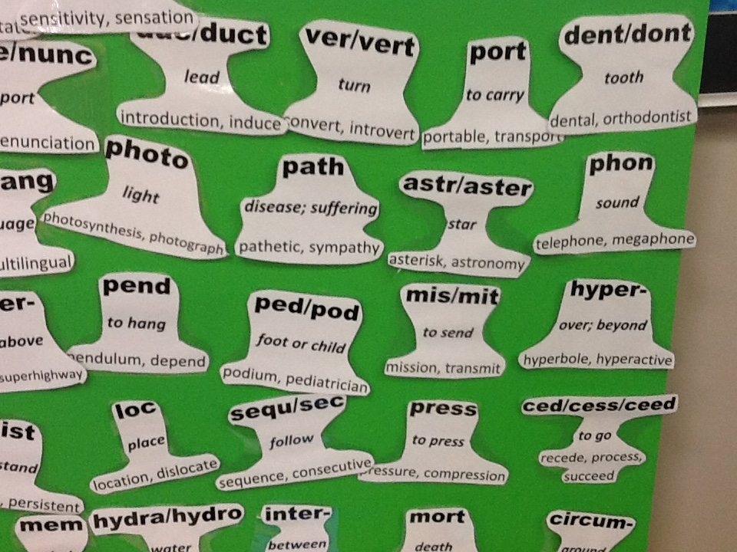
Root Words

Slide 53
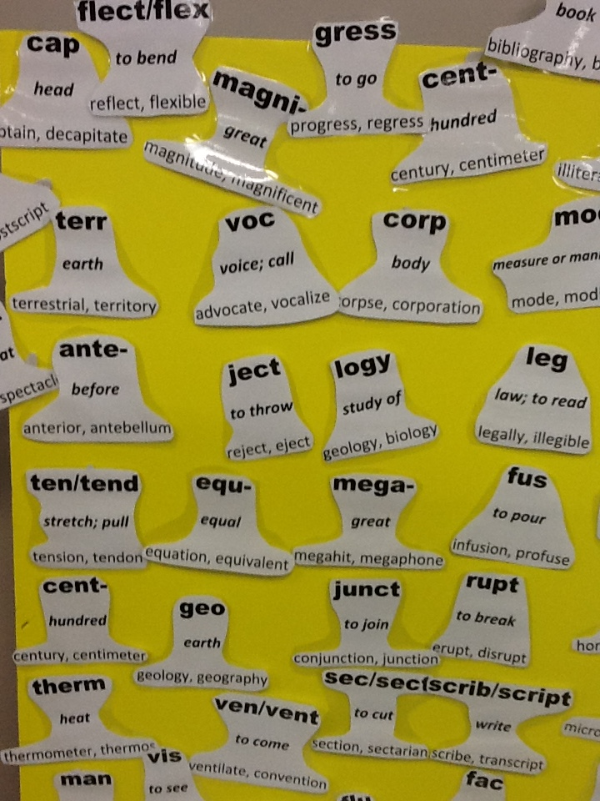
Root Words

Slide 54
Root Word Resources
http://bas.k12.mi.us/webpages/kseymour/vocabulary.cfm?subpage=1337936

Slide 55
Five Centers
Groups of 4 per center
3 minutes per center
Rotate clockwise

Slide 56
CENTERS
Center 1: Syllables: Segmenting
DATA: For students who need practice dividing words into syllables
Center 2: Prefixes and Suffixes
DATA: Supports with becoming aware of meaningful affixes
Center 3: Syllables: Blending/Combining
DATA: For student who struggle reading multisyllabic words
Center 4: Root words
DATA: Helps student become aware of meaningful units in words
Center 5: Prefixes/Suffixes: Meanings
DATA: For student who does not decode or recognize affixes
Follow-up activity - record words in notebook

Slide 57
Home Practice
Word Study Notebooks review and add new words
Word Search (find words with prefixes, suffixes, roots, more than one syllable)

Slide 58
???Questions about Word Reading???
Which activity will you try?

Slide 59
Passage Reading Fluency Measure

Slide 60
Curriculum Based Measurements Assess:
Phonological Skills
  Phoneme Segmentation
Alphabetic Principle/Phonics
  Letter Names
  Letter Sounds
  Word Reading
Fluency
  Passage Reading

Slide 61
Impact of Early Reading Skills on Comprehension
Comprehension is the goal – what gets in the way?
Profile 1: Word reading skills not at grade level
Profile 2: Word reading skills strong, but fluency not at grade level

Slide 62
Fluency
Reading words in passages accurately with appropriate rate (automatically) and proper expression
Big ideas:
  Children must accurately and automatically read words
  Supports comprehension

Slide 63
Common Challenges
Children are not automatic but accurate; interferes with comprehension and stamina
Phonics skills are not yet mastered
Choppy reading – no phrasing
Tracking difficulties (skips lines, loses place)

Slide 64
Considerations for ELLs
Students must listen to books read aloud in English
Oral proficiency provides foundation for reading fluency
Accent is fine when addressing fluency

Slide 65
Data – When does a Student require Fluency Instruction?
If a student scores 10 or more words below the 50th percentile, fluency instruction is needed
Avoid speed reading by asking comprehension questions
Always model appropriate rate and phrasing
If the student struggles with many words, the passage is too difficult
Provide support with word reading errors

Slide 66
Instruction

Slide 67
Instruction: Echo Reading
Helps student develop confidence and fluency.
Read aloud a line of text.
Student reads the same line.
Take turns reading and rereading the same lines.
When the student reads with more expression and fluency, student reads aloud on his/her own.

Slide 68
Instruction: Repeated Reading
Repeated reading increases oral reading fluency.
Students must have initial word reading skills but demonstrate inadequate reading fluency for their grade level.
During repeated reading, a student reads a passage aloud at least three times.
Teacher selects a passage of about 50 to 200 words in length. (PASSAGE: not too easy and not too hard!)
If the student misreads a word or hesitates for longer than 3 seconds, the teacher reads the word aloud, and the student repeats the word correctly.
If the student requests help with a word, the teacher reads the word aloud or provides the definition.
The student rereads the passage until he or she achieves a satisfactory fluency level (REMINDER: no more than 3-4 times).

Slide 69
Instruction
In pairs (select a teacher and a student):
  Student reads passage
  Teacher and student count words correct per minute
  Teacher and student graph results
  Teacher teaches words student struggled with
Echo Reading
  Teacher models appropriate rate and phrasing
  Student mimics teacher
Repeated Reading
  Student practices
  Teacher times student; student counts words correct per minute
  Student graphs
Evaluate reading

Slide 70
Home Practice
Repeated reading – practice passages use the A-Z readers or poems

Slide 71
???Questions about Fluency???

Slide 72
SUMMARY!
Diagnostic Assessment: QPS and Spelling Inventory
Phonological Awareness
  Elkonin boxes
  Sound activities (changing vowels to create new words, hearing initial sounds in words)
Letter names/sounds: Matching, letter search, add letters to Elkonin
Word – high frequency
  Language Experience Approach, word search, word study notebooks
Phonics
  LEA, word study notebooks, syllable work, prefixes and suffixes, root words
Fluency
  Repeated and echo reading with graphs and self-evaliation

Slide 73
THANK YOU!

