Slide 1
Integrating Language Learning into High School Content Lessons
Alicia Van Borssum, EdD
Warner Center for Professional Development
University of Rochester

Slide 2
Objectives for Today
Content Objectives
Participants will examine a step-by-step framework for embedding English language development in high school content lessons.
Participants will experience the framework through a model of language development in a Living Environment lesson.
Participants will apply the framework to a high school content lesson (math, science, ELA or social studies) and peer-review a partner’s application of the framework.
Language Objectives
Participants will listen to the steps of the framework and read along.
Participants will skim a Living Environment lesson to analyze it for linguistic demands.
Participants will follow the steps of the framework to write a language objective and an exercise to practice it in a content lesson. They will read and comment on a peer’s objective.

Slide 3
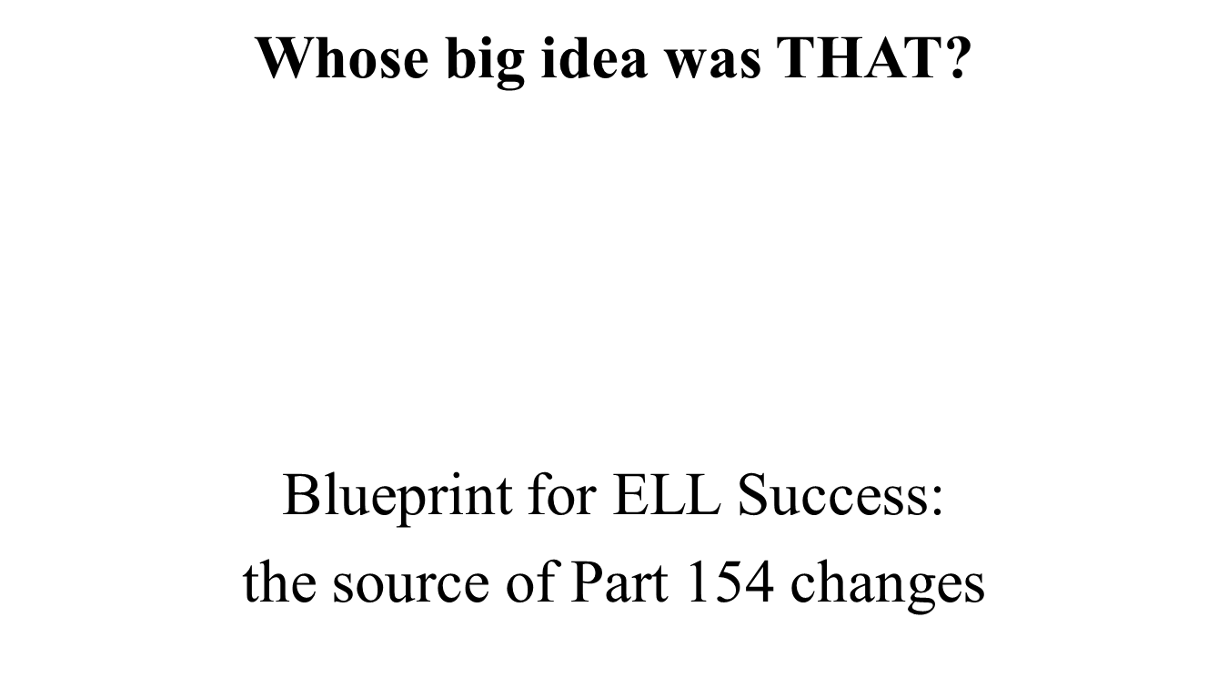
Change in Regs for ELLs

Slide 4
Principle 3 four rigorous instructional practices for ELLs
Engage ELLs in instruction that is grade-appropriate, academically rigorous, and aligned with school/ district standards by:
Articulating specific content and language objectives.
Providing opportunities for students to discuss content and problem-solve with peers.
Anchoring instruction by using research-based practices: multimedia, visuals, graphic organizers, etc.
Using academic-language and content-area supports to move ELLs along language development continuum

Slide 5
Principle 3 four rigorous instructional practices for ELLs
Engage ELLs in instruction that is grade-appropriate, academically rigorous, and aligned with school/ district standards by:
Articulating specific content and language objectives.

Slide 6
How do I embed English language learning into content lessons?
Step by step!

Slide 7
Step 1
Establish:
What is the content of the lesson?
What, exactly, are students learning about?
What is the essential concept?
Ex: the parts of a cell
how to find the circumference of a circle
what is a metaphor
the causes of World War 1

Slide 8
Step 2
Ask yourself:
What are the linguistic demands of the lesson?
What will students be expected to do with language in order to learn the content? What will they be expected to do with language to show they learned the content? Do they need explicit instruction on those language skills, vocabulary, tasks, structures?

Slide 9
Step 3
Think:
What are my student’s language needs?
What is his/her proficiency level in English?
What does he/she need to know how to do with English in the context of this lesson that will prove useful in other contexts?

Slide 10
Step 4
Choose:
What is one language point I could target or teach explicitly within the linguistic demands of the lesson, my student’s needs, and an application of the learning in English in other contexts?

Slide 11
Step 5
Write:
The language objective. It can be vocabulary, grammar, language function, language skills, tasks, language learning strategies: see Himmel article from www.colorincolorado.org
Student(s) will be able to….
The objective is meant mostly to focus you. What language skill are you going to target that will prove useful in other school contexts?

Slide 12
Step 6
Create:
A short exercise to help students with the point of language you decided to target. Use ENL resources, your own ideas, colleagues’ ideas for help.

Slide 13
Step 7
Check:
Does the language work I created:
Come naturally from the content of the lesson?
Involve listening, speaking, reading, and/or writing English?
Promote useful English skills beyond the context of this lesson?
Embed language in a meaningful context?
If so, try it!

Slide 14
What does the seven-step framework look like in real life?
Living Environment Unit 1:
Characteristics of Living Things
Do all cells have the same structure?

Slide 15
Step 1
Establish:
What is the content of the lesson?
What, exactly, are students learning about?
Examine the lesson. Talk with a neighbor.
Share.

Slide 16
Step 2
Ask yourself:
What are the linguistic demands of the lesson?
What will students be expected to do with language in order to learn the content? What will they be expected to do with language to show they learned the content? Do they need explicit instruction on those language skills, vocabulary, tasks, structures?
Make a list of linguistic demands. Share.

Slide 17
Step 2
Make a list of linguistic demands
Technical vocabulary
What’s an analogy?
Make a claim and support it
Compare and contrast
“Reading” a diagram/ “speaking” a diagram

Slide 18
Step 3
Think:
What are my student’s language needs?
What does he/she need to know how to do with English in the context of this lesson that will prove useful in other contexts?
What is his/her proficiency level in English?

Slide 19
Step 4
Choose:
What is one language point I could target or teach explicitly within the linguistic demands of the lesson, my student’s needs, and an application of the learning in English in other contexts?
What will give the most bang for the buck?

Slide 20
Step 5
Write:
The language objective. It can be vocabulary, grammar, language function, language skills, tasks, language learning strategies: see Himmel article from www.colorincolorado.org
Student will be able to….
The objective is meant mostly for you, to focus you on the skill you think will be useful throughout student’s school day .

Slide 21
Step 6
Create:
A short exercise to help student with the point of language you decided to focus on. Use ENL resources, your own ideas, colleagues’ ideas for help.

Slide 22
Create an exercise to focus on the language objective
How is a prokaryotic cell like a studio apartment and a eukaryotic cell like a mansion? Use sentence frames or a paragraph frame to scaffold this comparison.
A studio apartment is very small and simple. It has _________________________________________. A prokaryotic cell is like a studio apartment because ____________________________________________.

Slide 23
Create an exercise to focus on the language objective
Reading a diagram to speak a diagram.
The three types of bacterium have most of the same structures such as __________________.
The coccus bacterium is shaped like a _______, the spirillum like a _________, and the bacillus like a ___________.
A difference between the bacillus and the other two cells in this diagram is the ___________.

Slide 24
Create an exercise to focus on the language objective
3. Make a claim and support it.
The cells in Model 2 are more complex than the cells in Model 1. One reason for the greater complexity is ___________________. Another reason is ___________________. Finally, the cells in Model 2 are more complex because _________________.

Slide 25
Step 7
Check:
Does the language work I created:
Come naturally from the content of the lesson?
Involve listening, speaking, reading, and/or writing English?
Promote useful English skills that can be used in other academic contexts?
Embed language in a meaningful context?
If so, try it!

Slide 26
Your turn!
You will receive a lesson in either ELA, science, social studies, or math.
Skim the lesson.
Follow the steps for discovering linguistic demands and embedding language learning in the lesson.
When you are finished, find a partner to exchange lessons with. Look over their thoughts on language objectives and exercises to practice them. Can you add anything?

Slide 27
Resources for ENL Strategies
Colorincolorado: www.colorincolorado.org
Education Connection: www.obaverse.net free website for teachers of ELLs; you have to sign up for an account; send weekly tips; archived strategy ideas; webinars
Fifty Strategies for Teaching English Language Learners. Herrell & Jordan, Pearson, 2008.
The GO TO strategies: Scaffolding options for teachers of English language learners, K-12.
Levine, Lukens, & Smallwood, 2013.
http://www.ride.ri.gov/Portals/0/Uploads/Documents/Students-and-Families-Great-Schools/English-Language-Learners/go-to-strategies.pdf
Available online (free!) Search go to strategies pdf

Slide 28
Share and debrief
Using resources: don’t try to reinvent the wheel!
Use your colleagues: run your idea by a colleague or ask for ideas
Get to know the expectations of the standards and the school.
Be patient! It takes practice on the student’s part and on yours.

Slide 29
Questions?

Slide 30
Objectives for Today
Content Objectives
Participants will examine a step-by-step framework for embedding English language development in high school content lessons.
Participants will experience the framework through a model of language development in a Living Environment lesson.
Participants will apply the framework to a high school content lesson (math, science, ELA or social studies) and peer-review a partner’s application of the framework.
Language Objectives
Participants will listen to the steps of the framework and read along.
Participants will skim a Living Environment lesson to analyze it for linguistic demands.
Participants will follow the steps of the framework to write a language objective and an exercise to practice it in a content lesson. They will read and comment on a peer’s objective.

