Slide 1
Early Reading Skills: Phonological Awareness
Kathleen Lord
SUNY – New Paltz
lordk@newpaltz.edu

Slide 2
Objectives
Review terminology
Understand common challenges
View an instructional video
Preview instructional resources

Slide 3
Skilled Reading
Word recognition
Phonological awareness
Decoding/Encoding
Sight Word/High Frequency Words
Fluency
Language comprehension
Background knowledge
Vocabulary
Genre
Structure
Strategic reading

Slide 4
Purpose of Curriculum Based Measurements
Identifies and monitors students who might be at-risk
Quick and easy one-minute assessments
Early reading skills
Word recognition
Fluency

Slide 5
Curriculum Based Measurements Assess:
Phonological Skills
Phoneme Segmentation
Alphabetic Principle/Phonics
Letter Names
Letter Sounds
Word Reading
Fluency
Passage Reading

Slide 6
Impact of Early Reading Skills on Comprehension
Comprehension is the goal – what gets in the way?
Profile 1: Word reading skills not at grade level
Profile 2: Word reading skills strong, but fluency not at grade level

Slide 7
Phoneme Segmentation Measure

Slide 8
Phonemic Awareness: Segmentation (Grades K and 1)
What is it?
Ability to hear and separate individual sounds in spoken words
Why is it important?
Spelling (and reading)

Slide 9
Review the Article “Target the Problem”: Phonological and Phonemic Awareness
Phonological Awareness includes rhyming, onset/rime, alliteration, etc.
Phonemic Awareness is part of phonological awareness
Big ideas:
Children must hear the sounds
Supports spelling
Individual sounds (phonemes) are then attached to letters
Supports reading words

Slide 10
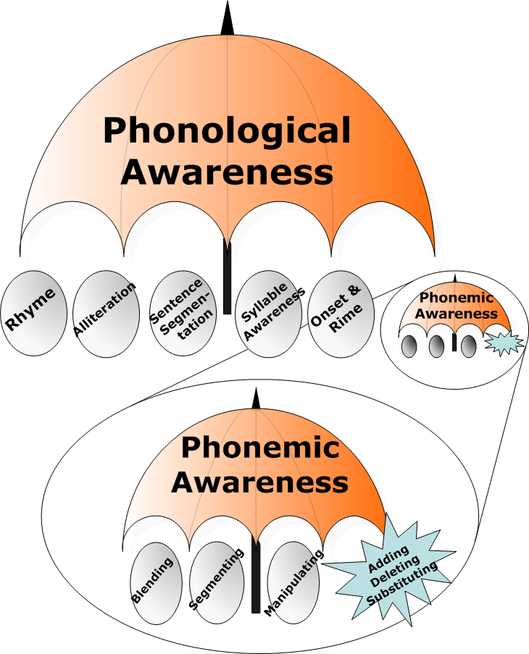

Slide 12
WHY? Phonological Awareness Sounds not letters!
Helps students understand how spoken language is represented in print
Differences between phonemes may be very subtle
Phonemes can get “stuck” together (e.g. blends)
Add letters to instruction as soon as possible

Slide 13
Common Challenges
Spelling captures phonemic awareness
Consonant blends
Jrem or jem (dream)
Short vowels
fn (for FAN)
pd (for PET)
Voicing confusion between similar sounds
b/p; g/c; d/t

Slide 14
Considerations for ELLs
Review ELLs article for more information:
English Language Learners and the Five Essential Components of Reading Instruction
PART 1: Phonemic Awareness
The sound may not be represented in native language
Phonemes conflict with native language (ch and sh are the same in Spanish)

Slide 15
Instruction

Slide 16
Elkonin Boxes: (Sound Boxes)
How to use Elkonin Boxes
Pronounce a target word slowly, stretching it out by sound.
Ask the child to repeat the word.
Draw "boxes" or squares on a piece of paper, chalkboard, or dry erase board with one box for each syllable or phoneme.
Have the child count the number of phonemes in the word, not necessarily the number of letters. For example, wish has three phonemes and will use three boxes. /w/, /i/, /sh/
Direct the child to slide one colored circle, unifix cube, or corresponding letter in each cell of the Elkonin box drawing as he/she repeats the word.
The example (next slide) shows an Elkonin Box for the word "sheep," which consists of three phonemes (sounds): /sh/ /ee/ /p/

Slide 17
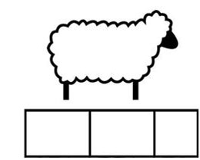

Slide 18
Instruction: Elkonin Boxes
https://www.youtube.com/watch?v=CIhurqhIk0c

Slide 19
Example
Link to movie clip
https://vimeo.com/201301034/169dbcc034

Slide 20
Resources
http://fcrr.org/resources/resources_sca_k-1.html
ARTICLE – additional information
http://www.readingrockets.org/article/how-now-brown-cow-phoneme-awareness-activities

Slide 21
THANK YOU!

