Slide 1
Early Reading Skills: Alphabet and Phonics
Kathleen Lord
SUNY – New Paltz
lordk@newpaltz.edu

Slide 2
Objectives
Review terminology
Understand common challenges
View instructional videos
Preview instructional resources

Slide 3
Skilled Reading
Word recognition
  Phonological awareness
  Decoding/Encoding
  Sight Word/High Frequency Words
  Fluency
Language comprehension
  Background knowledge
  Vocabulary
  Genre
  Structure
  Strategic reading

Slide 4
Purpose of Curriculum-Based Measurements
Identifies and monitors students who might be at-risk
Quick and easy one-minute assessments
  Early reading skills
  Word recognition
  Fluency

Slide 5
Curriculum-Based Measurements Assess:
Phonological Skills
  Phoneme Segmentation
Alphabetic Principle/Phonics
  Letter Names
  Letter Sounds
  Word Reading
Fluency
  Passage Reading

Slide 6
Impact of Early Reading Skills on Comprehension
Comprehension is the goal – what gets in the way?
Profile 1: Word reading skills not at grade level
Profile 2: Word reading skills strong, but fluency not at grade level

Slide 7
Letter Names and Letter Sounds Measures

Slide 8
Letter Names and Letter Sounds
(Grades K and 1)
What is it?
  Ability to name letters
  Ability to provide letter sounds
Why is it important?
  Spelling and reading

Slide 9
Review the Article “Target the Problem”:
Decoding and Phonics
Letter-sound relationships
Big ideas:
  Children must accurately and automatically identify letters
  Then children must be able to accurately and automatically provide the sound that corresponds with each letter
  Children must learn the alphabet and sounds that represent the 26 letters (both upper and lower case letters)
  Then children learn how two or more letters can come together to make one sound (th, ch, wh) – (the English language has 44 phonemes represented by many letter combinations)
  Supports spelling and reading words

Slide 10
Common Challenges
Children confuse short vowel sounds
Children confuse letters: b/d; p/q
Children are not automatic but accurate; interferes with reading

Slide 11
Considerations for ELLs
Review ELLs article for more information:
English Language Learners and the Five Essential Components of Reading Instruction
PART 1: Phonics
No formal instruction in function of print
Letters correspond with different sounds in native language
Some letters represent same sounds; other do not – particularly vowels

Slide 12
Short Vowel Bingo
Place picture cards face down
Taking turns, student selects top card
Student names the picture and says the middle sound (Vowel)
Student places chip on the letter that corresponds with short vowel sound
Continue until someone has a bingo

Slide 13
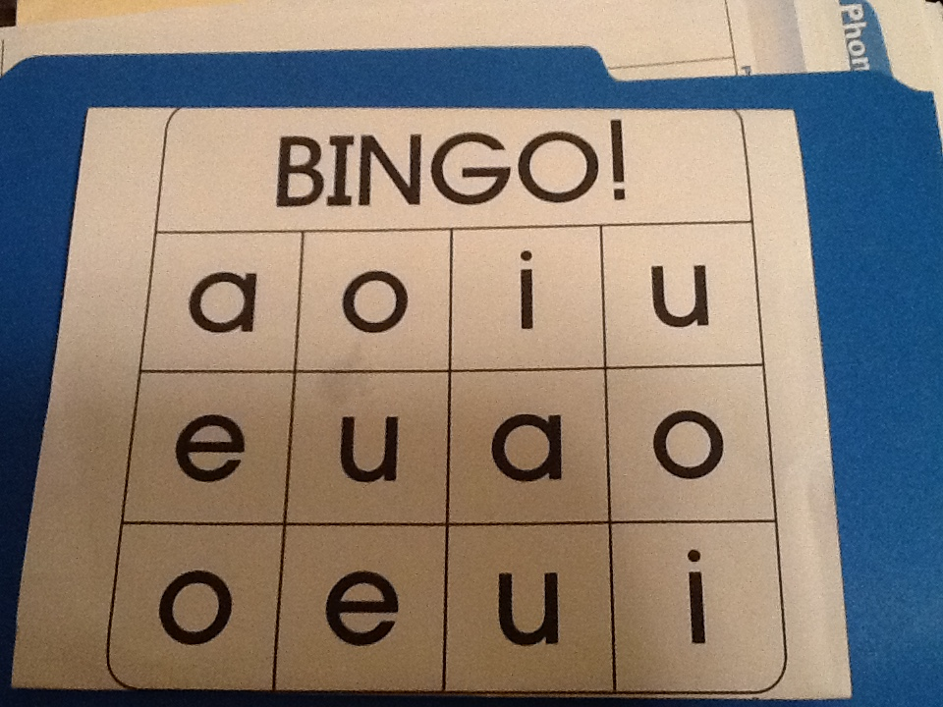

Slide 14
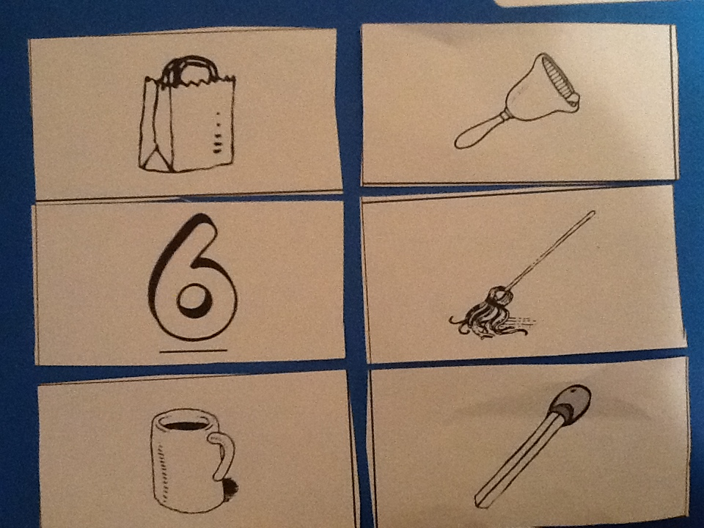

Slide 15
Link to Example
https://vimeo.com/201304244/220f975af4

Slide 16
Link to Example
https://vimeo.com/201306211/9ae9872895

Slide 17
Word Reading Fluency Measure

Slide 18
Word Reading Fluency
(Grades K - 3)
What is it?
  Ability to read words accurately
  Ability to read words automatically
Why is it important?
  Support reading fluency and comprehension

Slide 19
Review the Article “Target the Problem”:
Decoding and Phonics
Word reading (sight words)
Big ideas:
  Children must accurately and automatically identify grade-level words
  High frequency words become sight words (accurate and automatic)
  Supports spelling and reading words
  Supports fluency
  Supports comprehension

Slide 20
Common Areas of Difficulty
Children are not automatic but accurate; interferes with reading
Phonics skills are not yet mastered
  Patterns of difficulty can be recognized
  When reviewing errors, note common errors
    Short vowels, digraphs (ph, sh, ch, th), long vowels (silent-e, vowel teams), words with more than one syllable

Slide 21
Word Recognition Skills:
Instructional Sequence
Phonics skills – following the Common Core State Standards
Determine skills according to grade
  Kindergarten: Letters, letter sounds, high-frequency words at grade level
  Grade 1: Short vowel words, consonant blends, consonant digraphs, silent-e words
  Grade 2: Vowel teams and diphthongs, r-controlled vowels, multisyllabic words
  Grade 3 and beyond: Prefixes/suffixes; syllable patterns

Slide 22
STRATEGY: High-Frequency Words
High-frequency word lists (Dolch)
Instruction:
  Word Rings: 10 words on a ring or in envelope
    3 new words
    4 words still learning
    3 known words
  Read it, spell it, say it
  Include words in a Word Study Notebook

Slide 23
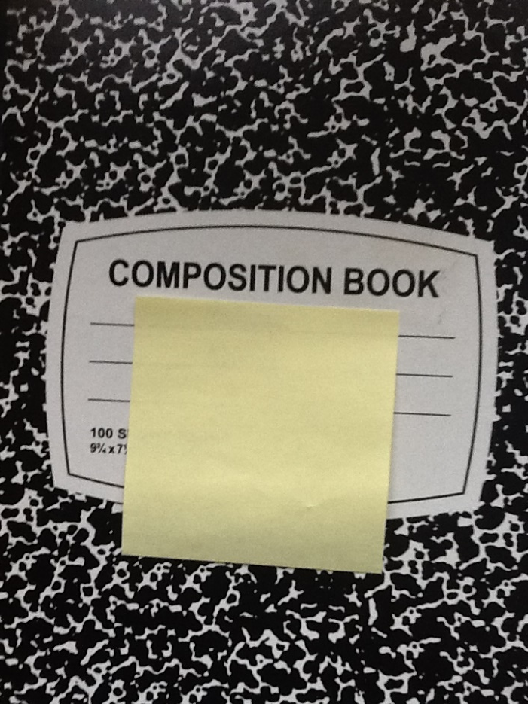
Word Study Notebook

Slide 24
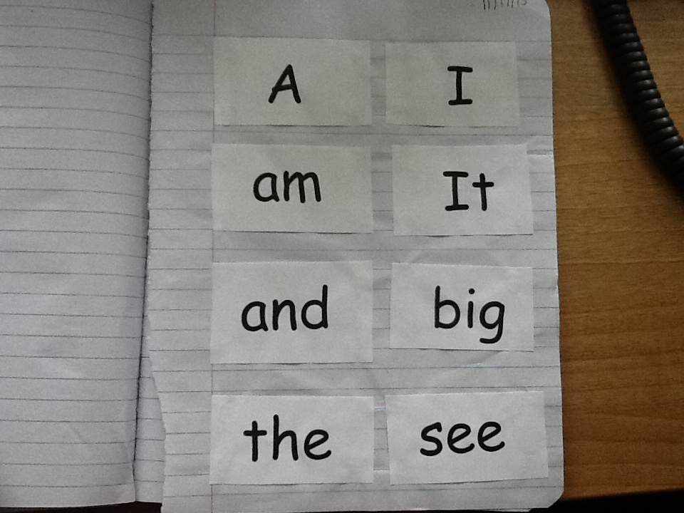
Instruction: High-Frequency Words

Slide 25
Instruction: Multi-syllables
Students in grades 2 and above require instruction in words with more than one syllable:
2 effective approaches
  Syllable awareness and syllable types
  Morphemes (meaningful word parts)
    “Photo” means LIGHT
    “Therm” means HEAT
    “Inter” means BETWEEN
      INTERNATIONAL – Between countries

Slide 26
Instructional Resources
Grades K-1
http://fcrr.org/resources/resources_sca_k-1.html
http://www.starfall.com/n/level-k/index/load.htm
Grades 2-5
http://fcrr.org/resources/resources_sca_2-3.html
http://fcrr.org/resources/resources_sca_4-5.html
ARTICLE – additional information
http://www.readingrockets.org/article/letters-and-sounds-practical-ideas-parents

Slide 27
THANK YOU!

