Slide 1
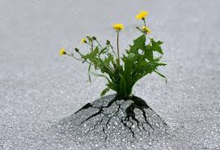
Positive Youth Development
Jutta Dotterweich
ACT for Youth Center of Excellence
Cornell university
November 30, 2016

Slide 2
AGenda
PYD is informed by resiliency research
What does the research tell us?
How do we use it in our work with young people?
Resources

Slide 3
Positive Youth Development
A philosophy or approach that guides communities in the way they organize programs, supports and opportunities so that young people can develop to their full potential.
Focus on building positive outcomes
Youth voice and engagement
Long-term involvement/Developmentally appropriate
Universal/Inclusive
Community-based/Collaborative

Slide 4
Community
Family
Supports
Services
YOUTH
Peers
Agencies
Youth-serving
Opportunities
School

Slide 5
What is Resiliency?
Resiliency has been defined as the capacity to spring back, rebound, successfully adapt in the face of adversity

Slide 6
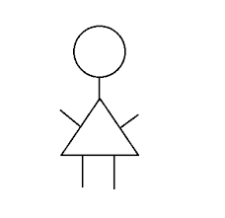
Activity
Think of young people you work with

Slide 7
Risk and Protective Factors Framework
Risk Factors
Behavior
Outcome
Protective Factors

Slide 8
Werner & Smith: Classic Resiliency Study
Longitudinal study
698 infants born in 1955
Kauai, Hawaii
Children followed up at ages 1, 2, 10, 18, 32, & 40
One third of sample exposed to at least 4 familial risk factors before age 2.
Poverty
Perinatal health problems
Congenital handicaps
Low parent education
Familial alcoholism
Violence
Instability/discord
Mental Illness

Slide 9
A Longitudinal Look at Risk and Resilience
Werner & Smith (1982, 1992, 2001)
High Risk
High Risk
High Risk
Resilient
Resilient
Birth Cohort = 698
Age 18
Ages 32 & 40
1/3 of cohort
multiple risk factors
2/3 of high risk group exhibited problem behaviors
5/6 of high risk group bounced back

Slide 10
Nurturing Resilience
Internal Protective Factors
Environmental Protective Factors
Social Competence
Problem Solving Skills
Autonomy
Sense of purpose, belief in a bright future
Caring Relationships
High Expectations
Opportunities for participation

Slide 11
Supportive Brain Research
The brain has a powerful ability to change, adapt, and rewire itself throughout life → Plasticity
Individual neurons grow, and new ones are added to the active circuits
It changes how it uses its genetic code, in response to life experiences
Stimulation, nutrition, exercise, stress, all modify this growth rate of neurons
The Developing Brain: Implications for Youth Program. 2014
http://www.childtrends.org/our-research/the-kristin-anderson-moore-lecture-series/

Slide 12
2 Core Strategies
Create supportive and caring environments
Nurture individual strengths

Slide 13
Identify Internal Strengths
Social Competence | Problem Solving | Autonomy | Sense of Purpose & Belief in the Future
-Responsiveness -Communication skills -Could recruit support -Empathy and caring -Compassion and forgiveness -Pro-social behavior | -Ability to plan -Flexibility -Insight -Critical thinking -Resourcefulness | -Positive Identity -Internal locus of control -Mastery and self efficacy -Adaptive distancing and resistance -Self-awareness and mindfulness -Humor | -Goal direction, achievement motivation and educational aspirations -Special interest, creativity, imagination -Optimism and hope -Faith, spirituality and sense of meaning
Bonnie Benard. 2004
Notes:
Bonnie Benard

Slide 14
Activity
What are your resiliencies?
How did you learn about them?
How do you use them?

Slide 15
Build on Internal Strengths
You believe that young people have strengths (attitude)
You identify personal strengths (you look beyond the problems)
You teach them that they have strengths (name them, show them how they are being used, suggest how they can use them in the future)
You give it time – you persist

Slide 16
Find their spark!
"A spark is something that gives your life meaning and purpose. It’s an interest, a passion, or a gift.“ Peter Benson
http://www.search-institute.org/sparks
Search Institute Findings:
51% of youth report no spark;
55% of youth reporting a spark receive support for their spark

Slide 17
strategies
Social and Emotional Learning Toolkit
http://www.actforyouth.net/youth_development/professionals/sel/self-awareness.cfm
Strengths inventory
Activity/interest lists
Multiple intelligences
Exploring strengths
Draw a picture
Take photos
Career interests/vision of your future

Slide 18
Explore relationship strengths
Social preferences (2 columns: activities enjoy/don’t enjoy)
Famous people/heroes
http://myhero.com
Draw self-portrait
Collage (self-portrait)
Take photos (How are you with family and friends?)
Jennifer Fox. 2008

Slide 19
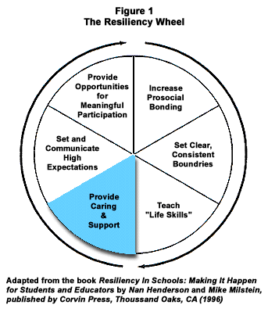
Build a Supportive Environment
Increase bonding or connectedness
Set clear and consistent boundaries
Teach life skills
Provide caring and support
Set and communicate high and realistic expectations
Provide opportunities for meaningful participation

Slide 20
Effective Youth development Programs
Physical and Psychological Safety
Appropriate Structures
Supportive Relationships
Opportunities to Belong
Positive Social Norms
Support for Efficacy and Mattering
Opportunities for Skill Building
Integration of Family, School and Community Efforts
National Research Council. 2002

Slide 21
Developmental Relationship
Express Care
Challenge Growth
Provide Support
Share Power
Expand Possibilities
http://www.search-institute.org/sites/default/files/a/Dev-Relationships-Framework.pdf

Slide 22
http://www.actforyouth.net/youth_development/professionals/

Slide 23
Resiliency in Action
Protective Factors in the family, school, community
Basic Youth Needs
Resilience Strengths
Youth Outcomes
Caring relationships
High expectations
Opportunities for participation and contribution
Safety
Love/Belonging
Respect
Autonomy/Power
Challenge/Mastery
Meaning
Social competence
Problem-solving skills
Autonomy
Sense of purpose and bright future
Improved social, health and academic behaviors
Reduced health-risk behaviors
meet
promote
result in

Slide 24
Resources
ACT: Principles of Positive Youth Development
http://www.actforyouth.net/youth_development/development/
ACT: Youth Development Research Base
http://www.actforyouth.net/youth_development/development/research.cfm
PYD 101 Online Course
http://www.pyd101.net

Slide 25
References
Benard, Bonnie. 2004. Resiliency. What We Have learned. WestEd. San Francisco
Fox. Jennifer. 2008. Your Child’s Strengths. Discover them. Develop them. Use them.Viking/Penguin
Henderson, Nan et al. 2007. Resiliency in Action. Resiliency in Action, Inc. San Diego
Werner, Emmy & Smith, Ruth. 1992. Overcoming the Odds: High Risk Children from Birth to Adulthood. Cornell University Press. New York
Wolin, Steven J. & Wolin, Sybil. 1993. The Resilient Self. Villard. New York
Web Resources
www.resiliency.com (Henderson)
www.projectresilience.com (Wolin)

Slide 26
Jutta Dotterweich
Director of Training
ACT for Youth Center of Excellence
BCTR, Cornell University
www.actforyouth.net
www.bctr.cornell.edu
jd81@cornell.edu
607-255-4108

