Slide 1
Migrant students in New York
Social Studies, Resources and Libraries
J’aimé Pfeiffer, School Library System Director, WSWHE BOCES

Slide 2
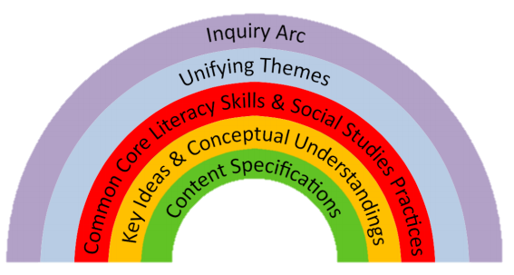
NYS SOCIAL STUDIES FRAMEWORK
LEARNING STANDARDS (1996)
C3 FRAMEWORK – “ARC OF INQUIRY”
UNIFYING THEMES
LITERACY SKILLS AND PRACTICES
KEY IDEAS AND CONCEPTUAL UNDERSTANDINGS
CONTENT SPECIFICATIONS
Notes:
Inquiry is “center stage
Students should be doing the thinking and doing the work
Students should be looking for more complex answers
Goal is to develop 21st century “global citizens”

Slide 3
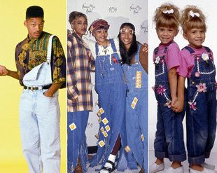
LEARNING STANDARDS FOR SOCIAL STUDIES (1996) – “CONTENT”
Standard 1: History of the United States and New York
Standard 2: World History
Standard 3: Geography
Standard 4: Economics
Standard 5: Civics, Citizenship, and Government

Slide 4
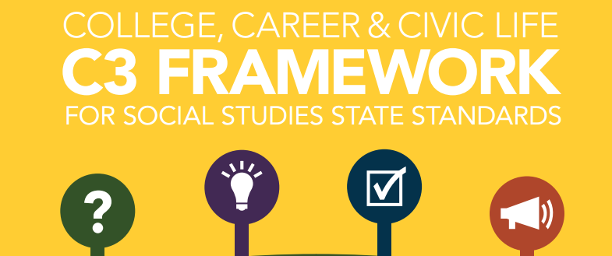
C3 FRAMEWORK & INQUIRY ARC
Developing questions and planning inquiries
Applying disciplinary concepts and tools
Evaluating sources and using evidence
Communicating conclusions and
taking informed action
Notes:
C3 is a student-centered inquiry curriculum model.

Slide 5
ANCHOR STANDARDS (ELA)
Reading
Key Ideas and Details
Craft and Structure
Integration of Knowledge and Ideas
Range of Reading and Level of Text Complexity
Writing
Text Types and Purposes
Production and Distribution of Writing
Research to Build and Present Knowledge
Range of Writing
Speaking and Listening
Comprehension and Collaboration
Presentation of Knowledge and Ideas

Slide 6
10 UNIFYING THEMES
Individual Development and Cultural Identity
Development, Movement, and Interaction of Cultures
Time, Continuity, and Change
Geography, Humans, and the Environment
Development and Transformation of Social Structures
Power, Authority, and Governance
Civic Ideals and Practices
Creation, Expansion, and Interaction of Economic Systems
Science, Technology, and Innovation
Global Connections and Exchange
Notes:
See “content specifications” to see where themes are introduced and developed.
Note the difference between these and 1996 Standards – more conceptual in nature. Use content to understand themes.

Slide 7
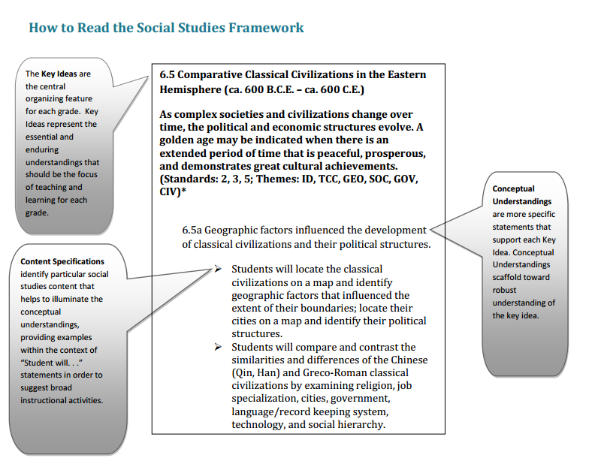
KEY IDEAS AND CONCEPTUAL UNDERSTANDINGS

Slide 8
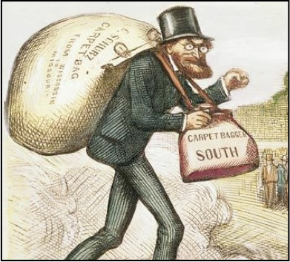
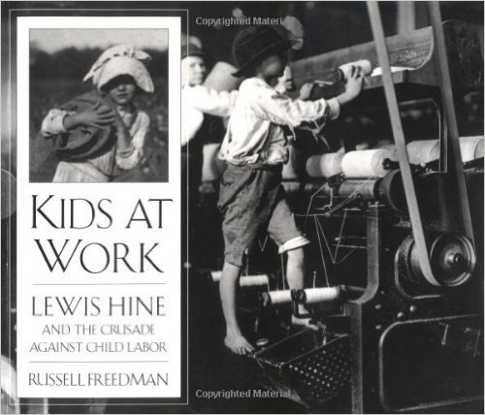
CONTENT SPECIFICATIONS
Notes:
Content relates back to themes.

Slide 9
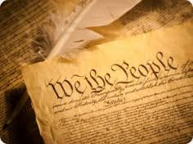
SOCIAL STUDIES PRACTICES
Gathering, Interpreting and Using Evidence
Chronological Reasoning and Causation
Comparison and Contextualization
Geographic Reasoning
Economics and Economic Systems
Civic Participation

Slide 10
Resources
PRINT
“Home” School Library
Online Catalog – Search for Books
Public Library
Open evenings & weekends
Internet Access
ELECTRONIC
eBooks
Databases – novelNY
No Cost – Access through “Home”School
Databases – “Home” School Library (Additional)
Usernames/Passwords through School
Digital (Online)
School & Public Libraries
School Library Services

Slide 11
novelny
Encyclopedia
Scholastic GO!
Elementary/Middle School Students
eLibrary Elementary
Kids Infobits
Opposing Viewpoints in Context
High School and College Students
General OneFile
Academic OneFile
Opposing Viewpoints

Slide 12
Library of Congress

Slide 13
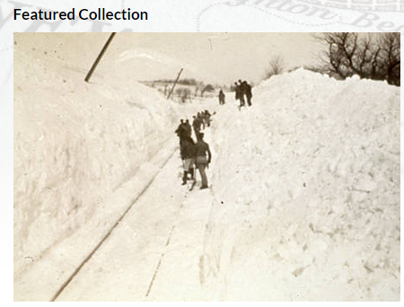
New York Heritage Digital Collections

Slide 14
Social Studies Organizations
www.socialstudies.org
http://nyscss.org

Slide 15
School Library System
SLS - LibGuides
Rosen eBooks
Overdrive eBooks
TeachingBooks

Slide 16
QUESTIONS???

