Slide 1

Data Security
NEW YORK STATE MIGRANT EDUCATION PROGRAM

Slide 2

R e v i e w
WHAT IS PERSONALLY IDENTIFIABLE INFORMATION?

Slide 3
Personally Identifiable Information (PII)
Any information about an individual maintained by an organization, including
Any information that can be used to distinguish or trace an individual’s identity, such as name, Social Security number, date and place of birth, mother’s maiden name, or biometric records
Any other information that is linked or linkable to an individual, such as medical, educational, financial, and employment information
As an MEP employee or contractor, you are responsible for protecting this data

Slide 4
Examples of PII
Combining pieces of
non-sensitive information could result in a set of information that is sensitive
E.g. Answer to security questions
Sensitive PII
Social Security
Drivers License
Passport Number
Date of Birth
Mother’s Maiden Name
Financial Account Numbers
Medical Records
Passwords
PII
Full Name
Email Address
Home Address
Business Card

Slide 5
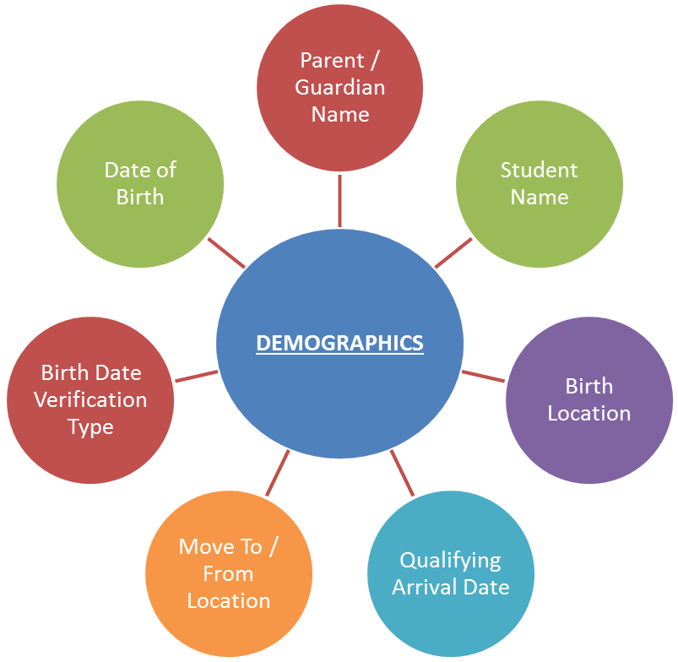
Migrant Student Data
Migrant student information collected through the Certificate of Eligibility (COE) includes Sensitive PII
Collection, transmission, and storage of this information must be protected
Only access the necessary data to perform your job duties (e.g. official purposes related to providing services)

Slide 6
Family Educational Rights and Privacy Act (FERPA)
Protects the disclosure of PII and educational records of students
Governs who has access to this data

Slide 7
FERPA Exceptions
School officials with legitimate educational interest
Other schools to which a student is transferring
Specified officials for audit or evaluation purposes
Appropriate parties in connection with financial aid to a student
Organizations conducting certain studies for, or on behalf of, the school
Accrediting organizations
To comply with a judicial order or lawfully issued subpoena
Appropriate officials in cases of health and safety emergencies
State and local authorities within a juvenile justice system pursuant to specific state law

Slide 8
P O L I C Y
BEHAVIOR | DEVICES | COMMUNICATION

Slide 9
Rules of Behavior
Ensure only authorized employees have access to private information
Keep documents containing PII in a locked container
Ensure Migrant Education Program information is not released without consent
Never share your account passwords with anyone else. You are responsible for all actions taken with your credentials
Staff should create $TR0ng passwords that use a combination of uppercase letters, lowercase letters, numbers, and symbols, and are changed regularly

Slide 10
Rules of Behavior
Log off computers whenever they are not in use
Be aware of individuals around you who can see your keyboard as you type in passwords
Be aware of social engineering and scams. These include phony calls from help desks claiming to offer support for a problem you were not aware of, or suspicious emails asking you to click a link and enter your credentials

Slide 11
Device Security
All devices containing PII should be encrypted and use a strong password to gain access
Mobile devices accessing PII should have a PIN
Make sure antivirus is always up-to-date
When transporting a device in a car, place it in the trunk. Never leave it in a car for a long period of time or overnight
Do not leave devices out in a hotel room, and store devices in a safe if possible
At the airport, never place devices in checked luggage

Slide 12
Secure Communications
TRANSMISSION OF PERSONALLY IDENTIFIABLE INFORMATION OVER THE INTERNET MUST ALWAYS BE ENCRYPTED!
Email accounts should use two-factor authentication
PII cannot be placed in the body of an email; instead, it must be sent as an encrypted attachment
The password for an encrypted attachment must be sent through a different form of communication
  Phone call
  Text
  Previously known password

Slide 13
Need help?
If you forget how to use the recommended file encryption programs, or need to show someone else how to use them, a reference sheet can be found at
http://nysmigrant.org/7zip

Slide 14
BREACH OF DATA
RISKS | CAUSES | REPORTING

Slide 15
Risks of improper handling
Risks to Migrant Children and Families
Identity theft, financial loss, and/or credit damage
Emotional distress
Loss of confidence in the government
Risks to MEP Employees
Disciplinary action resulting in: loss of clearance, loss of access to PII, or loss of employment
Penalties under the Family Educational Rights and Privacy Act Privacy Act
Diminished reputation
Risks to the MEP
Diminished reputation
Costs of mitigation and/or litigation
Impact on agency processes
Loss of the public trust

Slide 16
Causes
Can be a simple mistake, such as sending an email with PII to the wrong recipient
Can be the result of a computer virus infection
Can be theft of device
Lack of use of encryption
Many more
Better safe than sorry- report any warning signs

Slide 17
Reporting
Step 1: Contain the breach
Step 2: Contact immediate supervisor
Step 3: Document the breach
On occasion, the program director might request that you participate in a detailed evaluation of the events leading to the breach for official records, prevention, and other uses

Slide 18
DISCUSSION
“What if someone else sends me an email with PII?”

Slide 19
DISCUSSION
“What if I accidently send an email with PII?”

Slide 20
Thank you!
Follow-up exam available at nysmigrant.org/dataquiz

